Slide 1
Cifar100
Deep Learning
ST1504
- Deep Learning -
Soh Hong Yu
P2100775
DAAA/FT/2B/01

Slide 2
Exploratory Data Analysis
As the training set will be used to train the model, we will need a set of data for model tuning, and the testing set will be used to evaluate the final model, ensuring the model is generalise and not overfit to the validation set due to model tuning.
To decide what size of the validation set, I have decided to split the data by 80:20 of the train set as the validation set.
Encoded Labels [Cifar 100 superclass]
4, 30, 55, 72, 95 : aquatic mammals
1, 32, 67, 73, 91 : fish
54, 62, 70, 82, 92 : flowers
9, 10, 16, 28, 61 : food containers
0, 51, 53, 57, 83 : fruit and vegetables
22, 39, 40, 86, 87 : household electrical devices
5, 20, 25, 84, 94 : household furniture
6, 7, 14, 18, 24 : insects
3, 42, 43, 88, 97 : large carnivores
12, 17, 37, 68, 76 : large man-made outdoor things
23, 33, 49, 60, 71 : large natural outdoor scenes
15, 19, 21, 31, 38 : large omnivores and herbivores
34, 63, 64, 66, 75 : medium-sized mammals
26, 45, 77, 79, 99 : non-insect invertebrates
2, 11, 35, 46, 98 : people
27, 29, 44, 78, 93 : reptiles
36, 50, 65, 74, 80 : small mammals
47, 52, 56, 59, 96 : trees
8, 13, 48, 58, 90 : vehicles 1
41, 69, 81, 85, 89 : vehicles 2

Slide 3
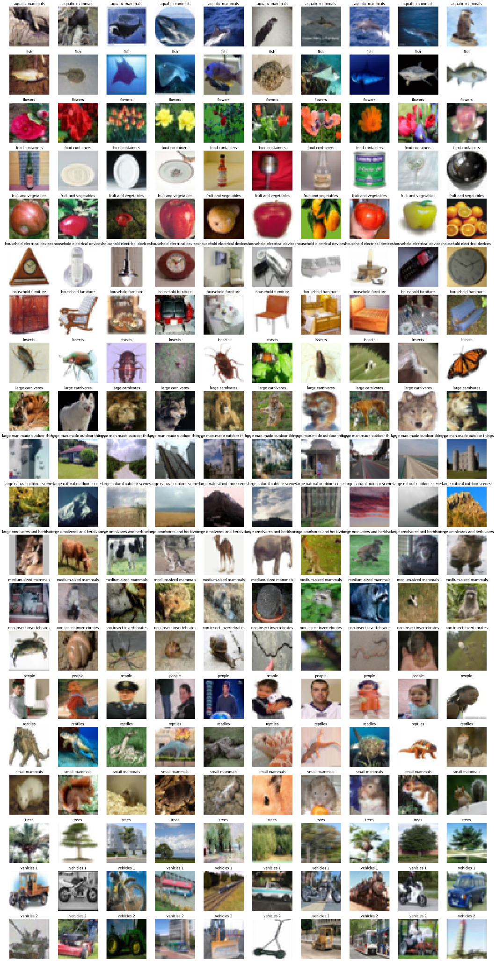
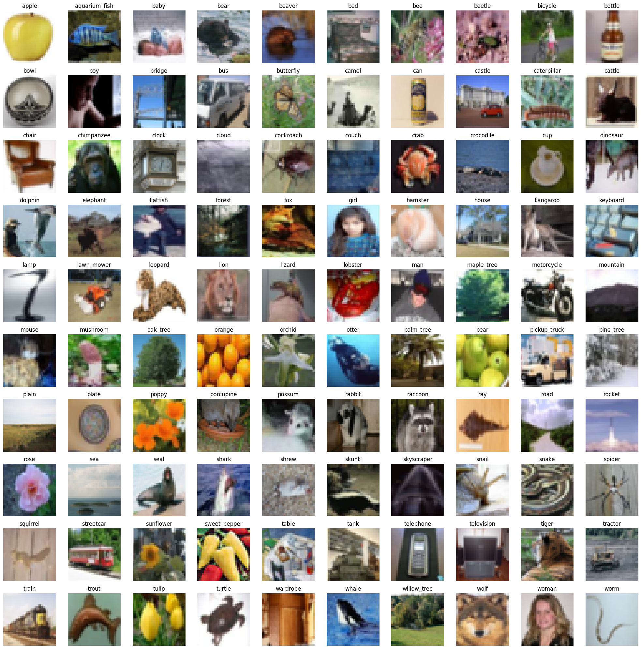
Exploratory Data Analysis
We can see that the images are not very consistent in the orientation.
Data augmentation where images can be flipped/cropped could be possible to do better prediction.
Based on the selection of images, There is no clear indication of missed identified items/wrongly augmented items from the dataset.

Slide 4
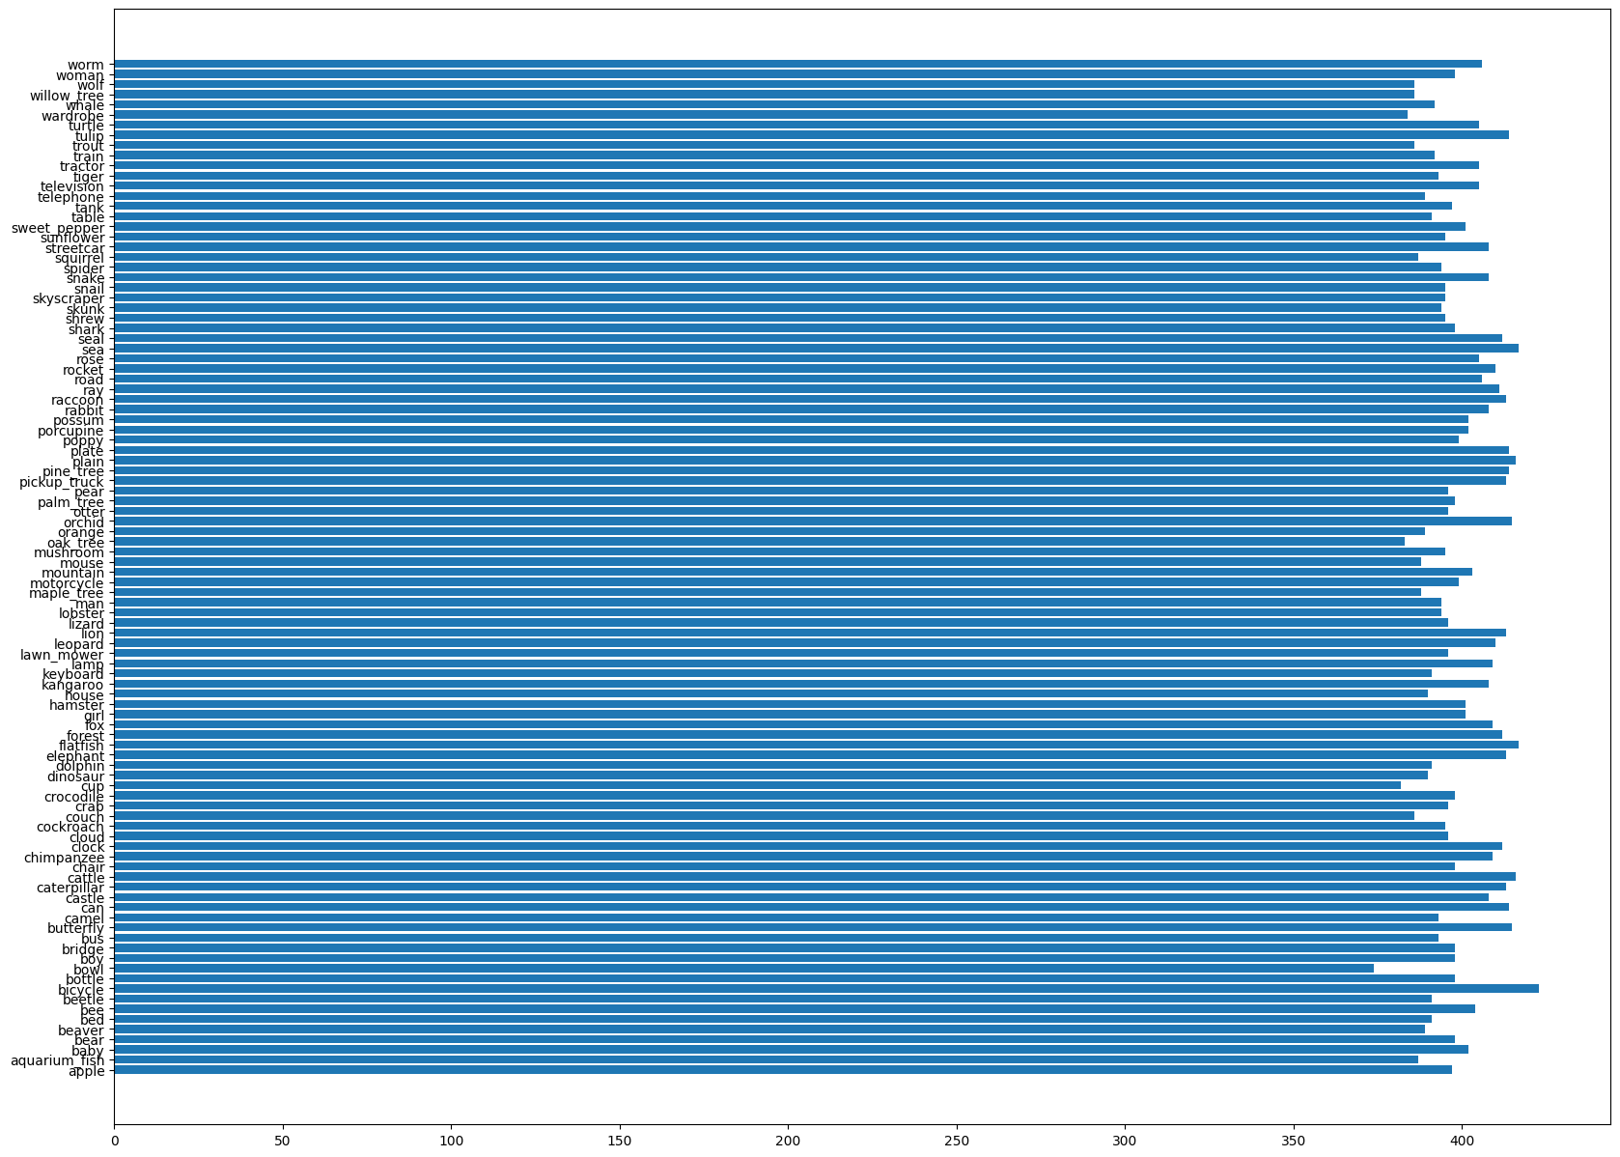
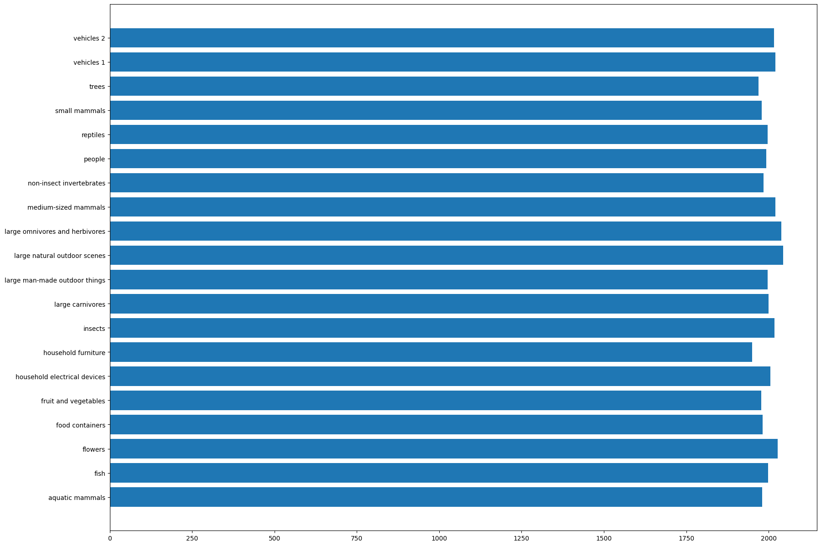
Exploratory Data Analysis
Distribution is even, Accuracy can be used as a scoring metrics
IMG_SIZE = (32, 32, 3)

Slide 5
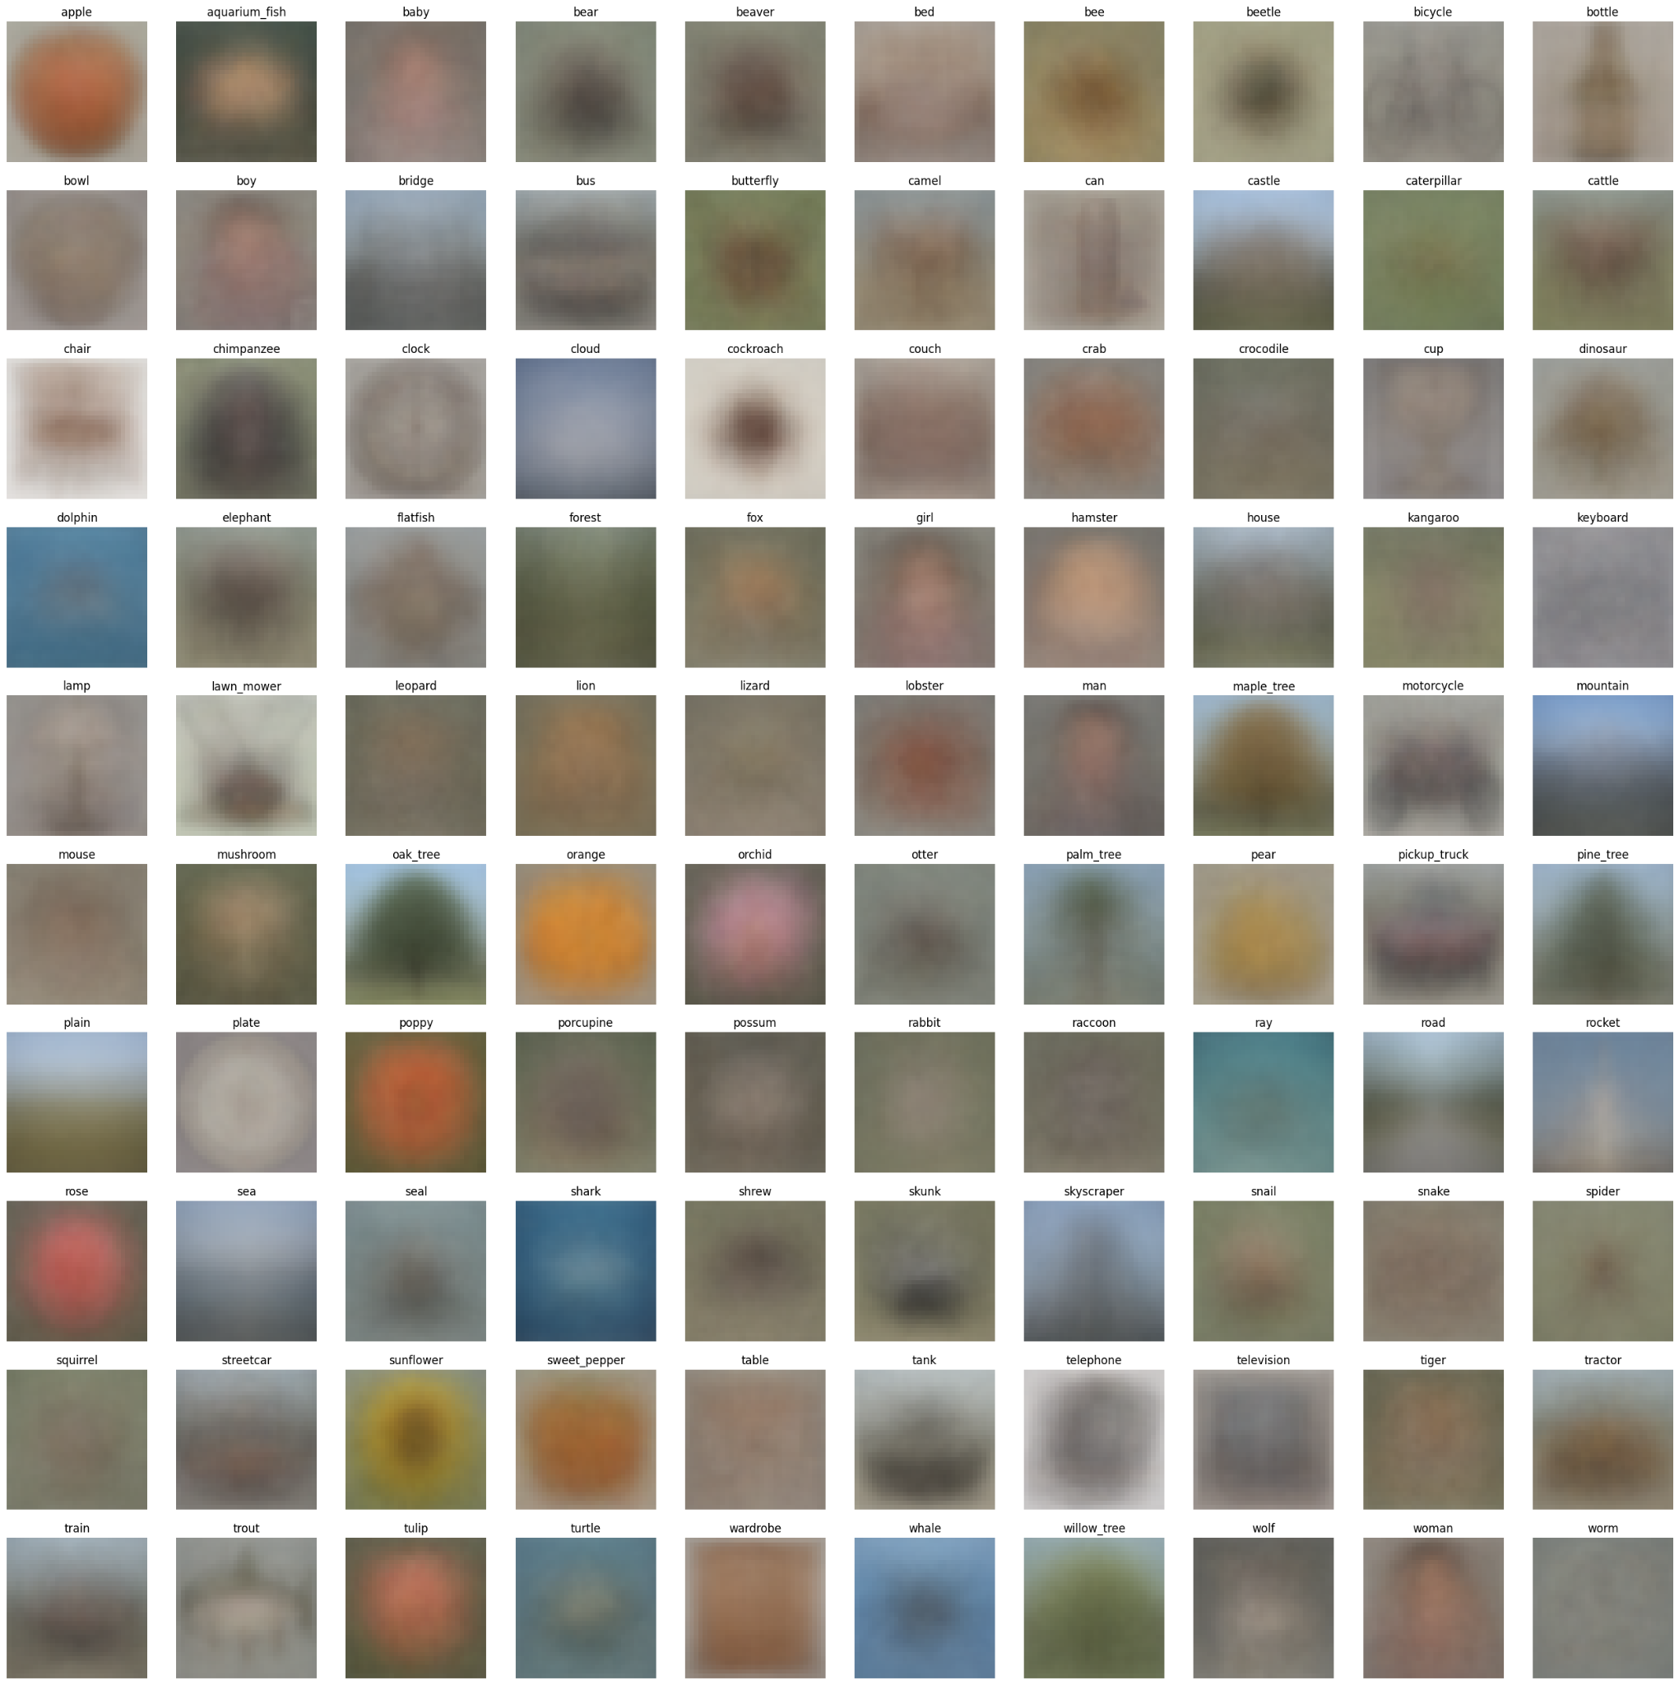
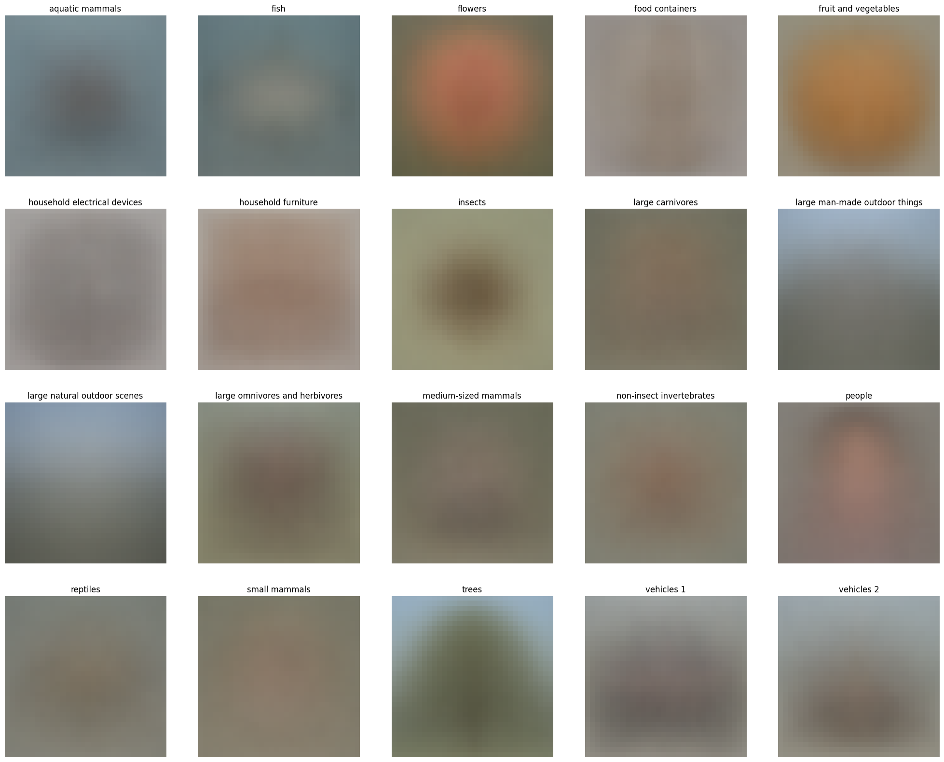
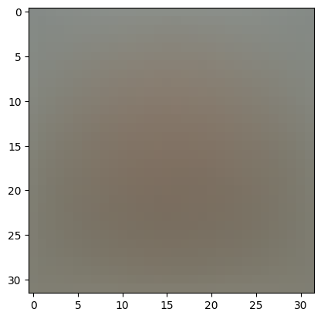
Image Averaging
To look through all the dataset, we will apply a technique called Image Averaging. It stacks all images in the dataset and average each other.
We can see that the images from each class is are sometimes harder to identify like worm & vehicle 2
There are also colors of similar shade like orange and sweet pepper

Slide 6
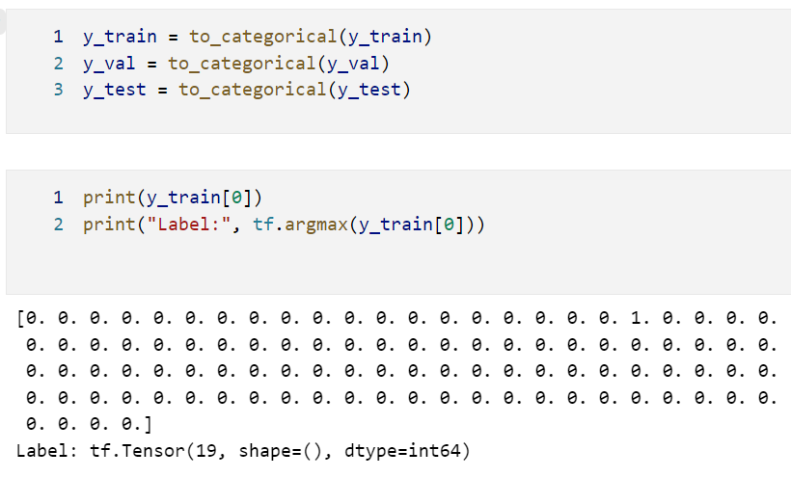
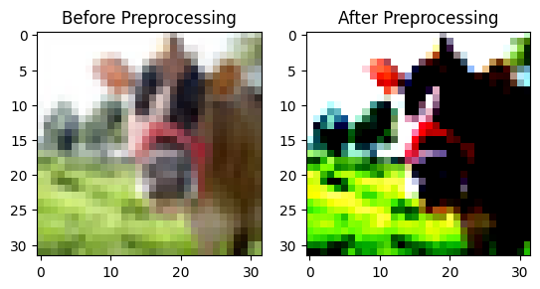
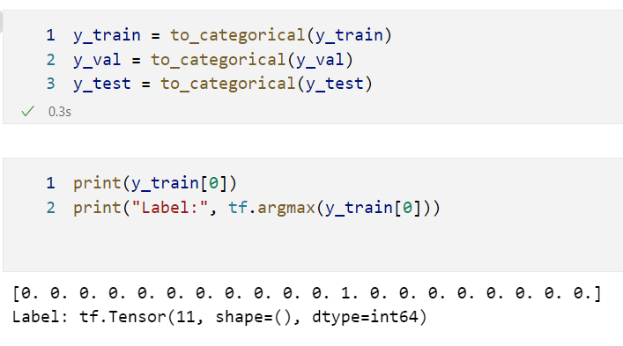
Data Preprocessing
Using tf.utils.to_categorical to one hot encode the labels
Use the Normalisation layer to normalise the image pixels

Slide 7
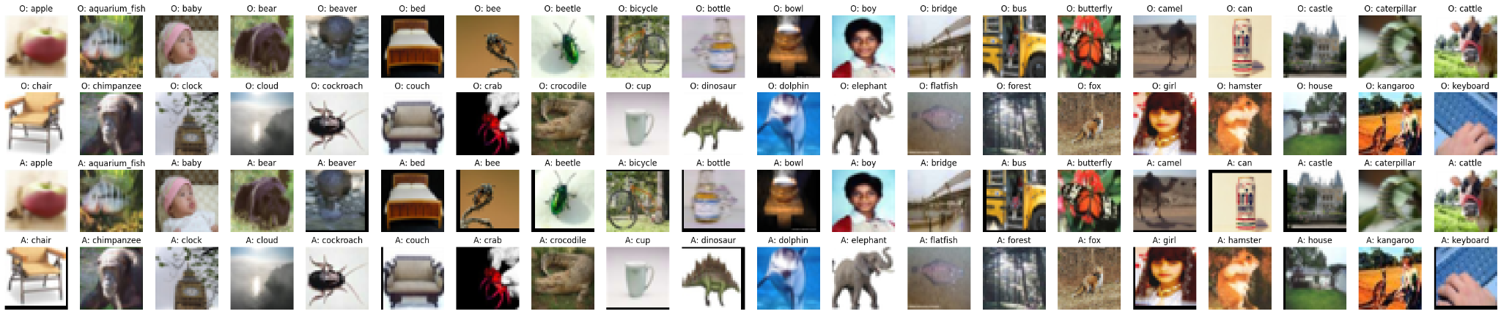
Data Augmentation - Basic
To prevent overfitting, we will apply data augmentation.
For this augmentation we will be using random flipping and translation up and down. This is because clothing are symmetrical and it gives the model a more generalised idea of the data. From the average images, we note that the images are some long and some short, therefore by shifting the images up and down it allows the model to know more about the lines and it’s relationship.

Slide 8
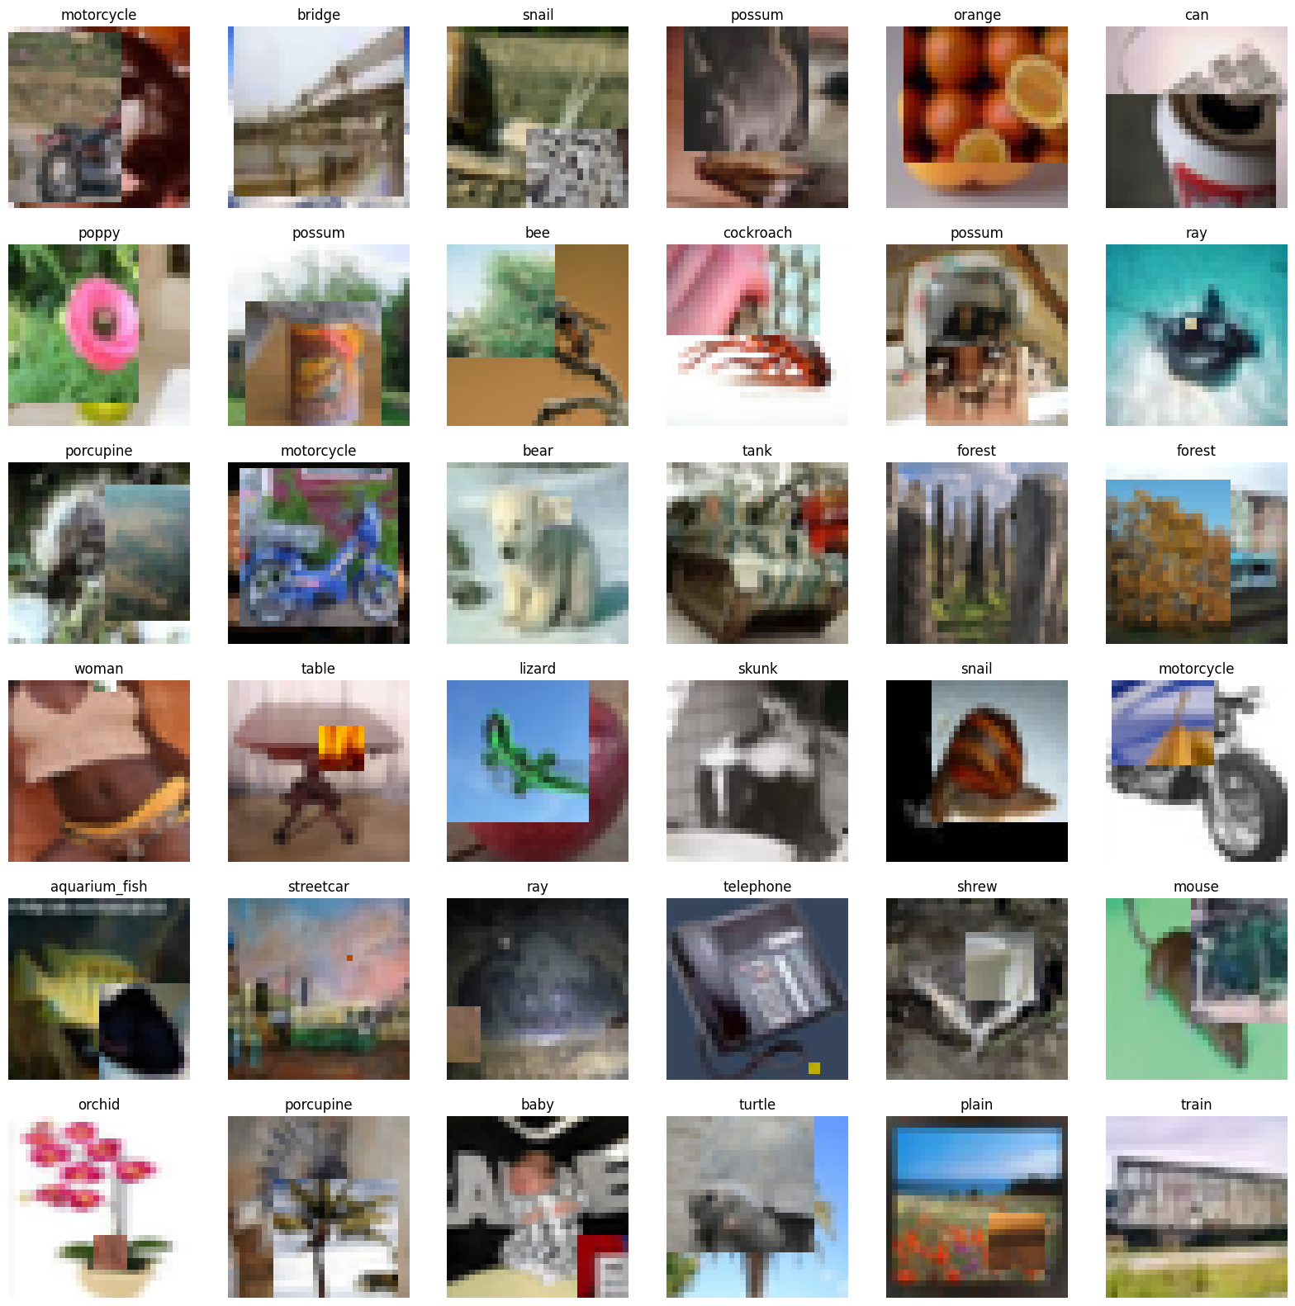
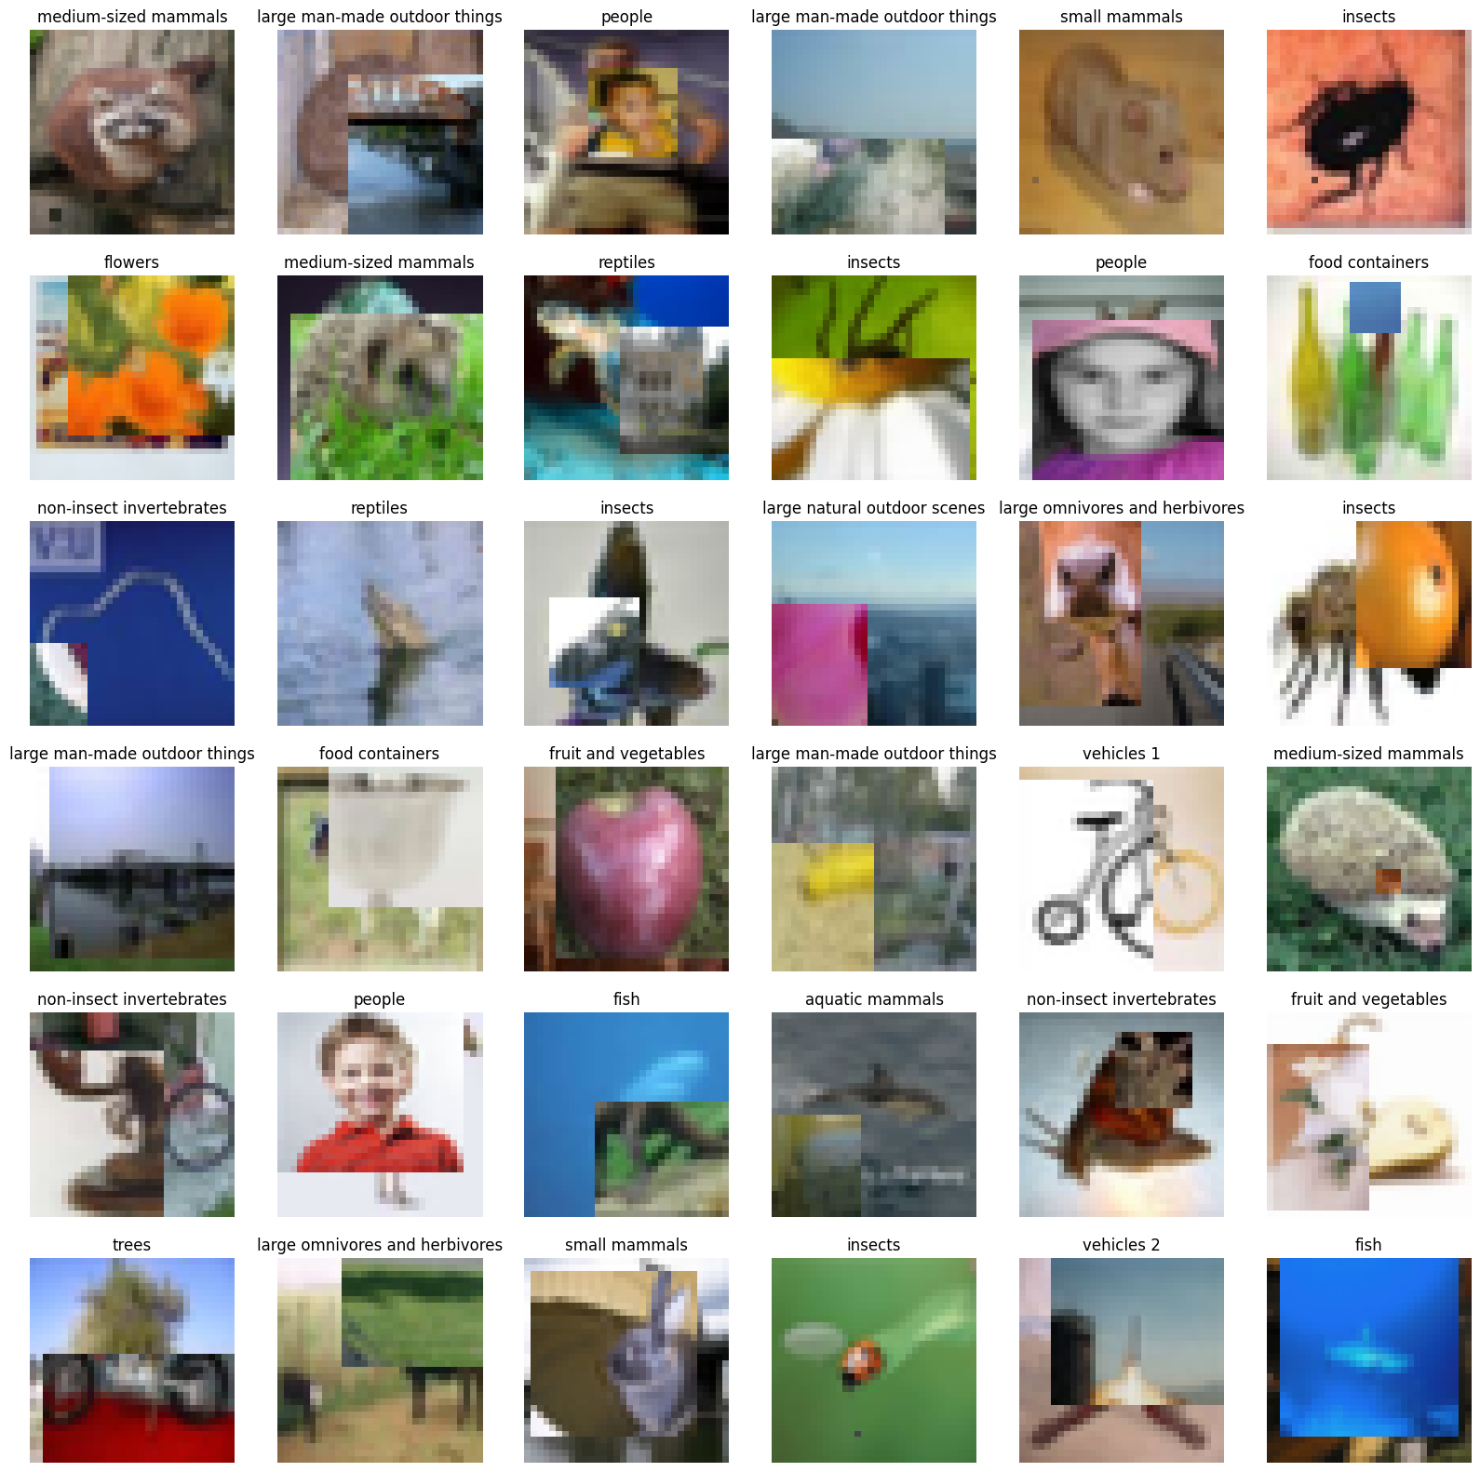
Data Augmentation - CutMix
To prevent overfitting, we will apply data augmentation.
This image augmentation method cuts patches and paste it among training images. This improves the model robustness against input corruptions and its out-of-distribution detection performances.

Slide 9
Building Models
To build our deep learning models, we will be using the different lists.
Fully Connected Neural Network Model (Baseline)
Conv2D Neural Network Model
CustomVGG Model
CustomVGG16 Model
CustomResNet-10 Model
EfficientNetV2 Model (Transfer Learning)
We will be using EarlyStopping to prevent overfitting,
and using the SGD optimizer instead of Adam. This is because Adam will take “shortcuts” and using a coordinate wise gradient clipping method. This makes it hard for classification as every detail of an image is important and therefore SGD is the more appropriate optimizer.

Slide 10
Fine Dataset
- Cifar 100 -

Slide 11
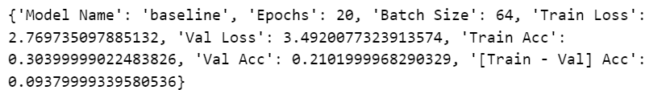
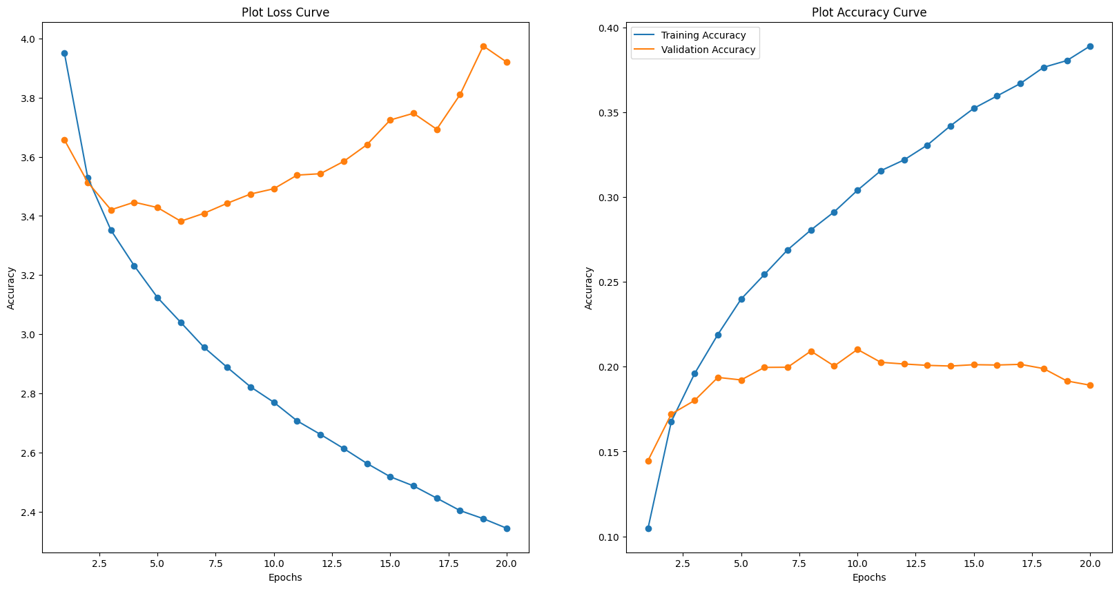
Baseline Model
We will build a baseline model with 3 hidden Dense layer.
From the loss curve, We can see that as the model increase in epochs, the model becomes more generalise and the loss functions starts decreasing too. However, the accuracy of both training and validation is very low at 30.3% and 21.1%. This means that the model is not very strong at predicting and it is similar to randomly choosing a label. Let's see if augmentations will improve the accuracy.

Slide 12
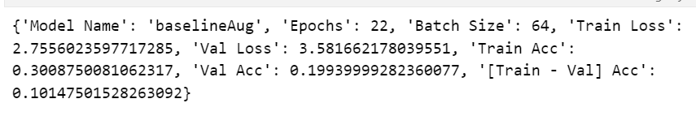
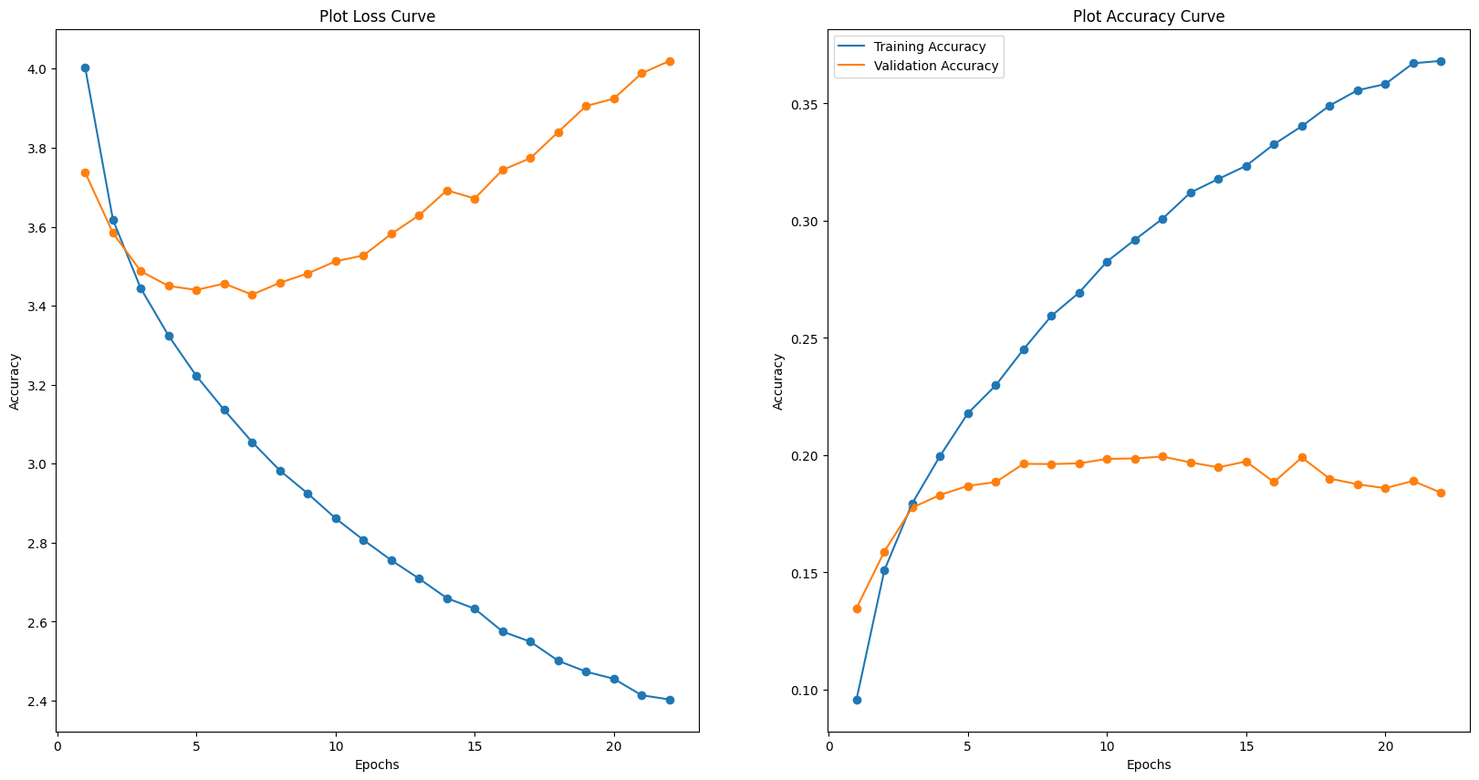
Baseline Model - Aug
We can also see that by augmenting the data, we see that even though the accuracy for both training and validation decreased, there is a slight decrease in validation loss which means that the model is becoming more generalise to fit to the dataset. However, as the accuracy is still very low, more improvements need to be made to make the model better.

Slide 13
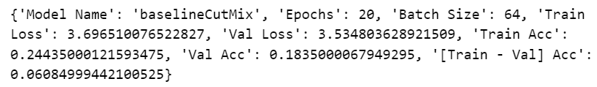
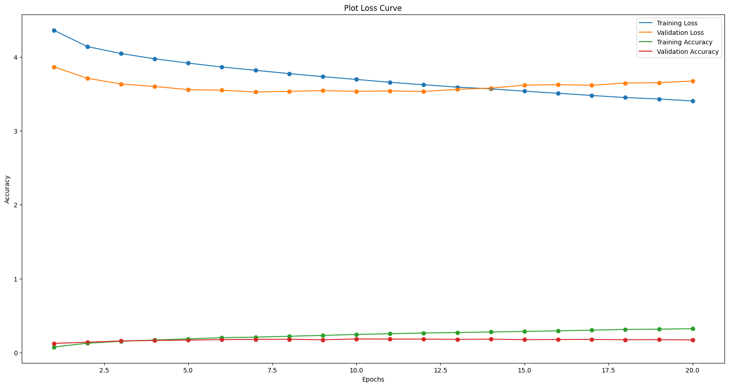
Baseline Model - CutMix
We can also see that by cut mixing the data, we see that the accuracy for both training and validation decreased, this is likely because the model is too simple and it was not able to find the similarity and between the different images. Furthermore, the dataset is relatively small which makes the cutmix algorithm not as strong as the cutmix algorithm works better with larger dataset like imagenet.

Slide 14
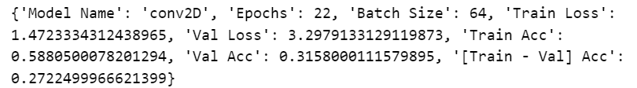
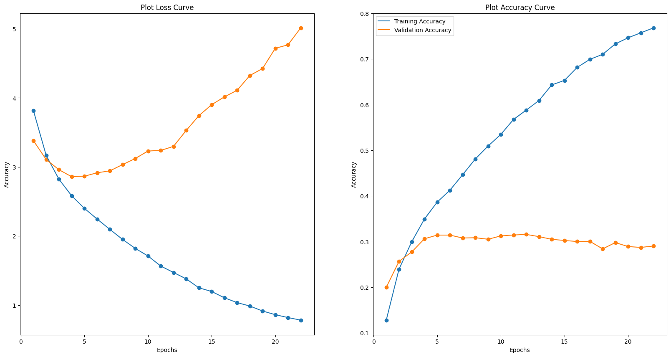
Conv2D Model
Comparing the Conv2D model with the baseline model, we can see that there is a huge difference in the training accuracy but the validation accuracy still remain around 30%. This suggest that there is some form of overfitting.

Slide 15
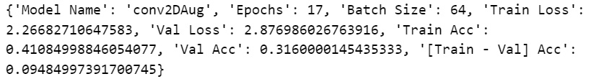
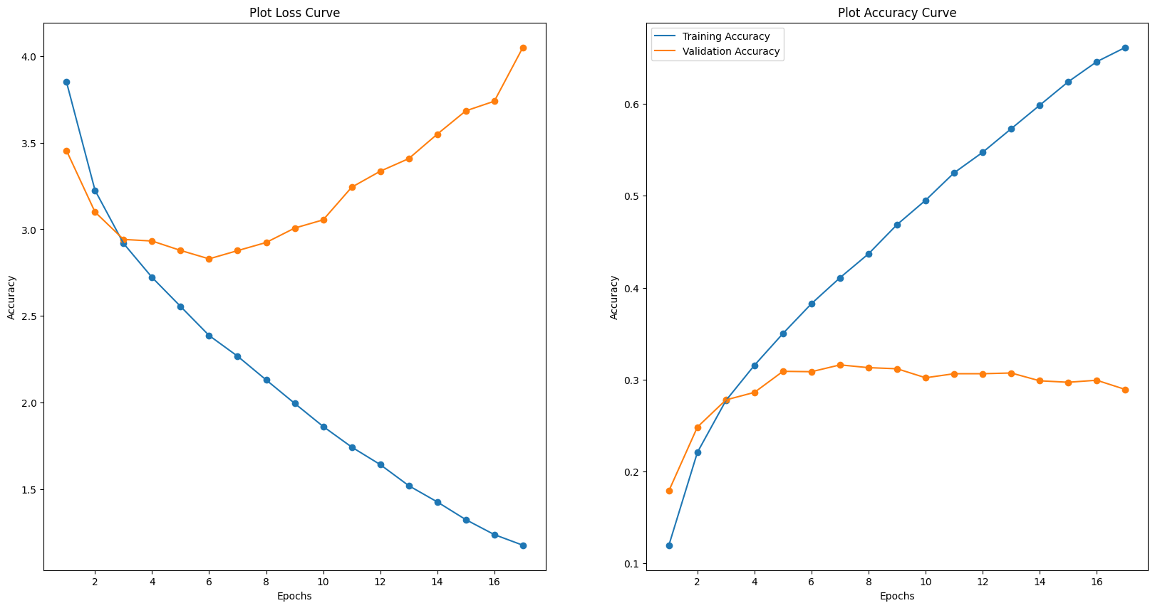
Conv2D Model - Aug
Comparing the augmented data trained under the conv2D model, we can see that although training accuracy decreased, the validation accuracy increased. This suggest that using the data augmentation method it decreased overfitting as well as improved the overall model.

Slide 16
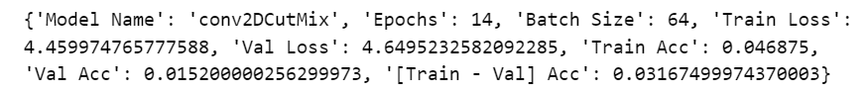
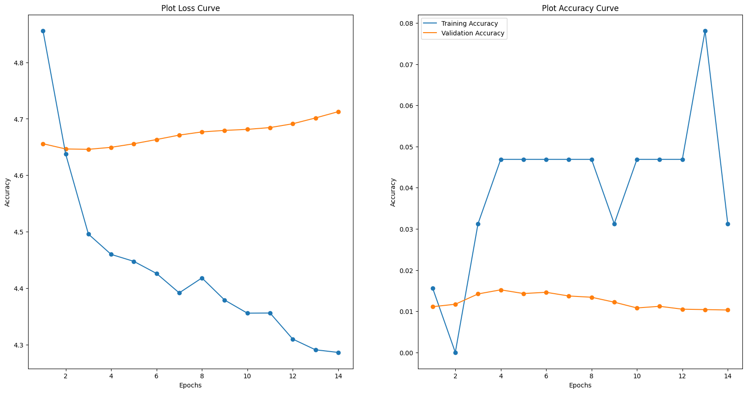
Conv2D Model - CutMix
To build our deep learning models, we will be using the different lists.
Fully Connected Neural Network Model (Baseline)
Conv2D Neural Network Model
CustomVGG Model
CustomVGG16 Model
CustomResNet-10 Model
EfficientNetV2 Model
We will be using EarlyStopping to prevent overfitting,
and using the SGD optimizer instead of Adam. This is because Adam will take “shortcuts” and using a coordinate wise gradient clipping method. This makes it hard for classification as every detail of an image is important and therefore SGD is the more appropriate optimizer.

Slide 17
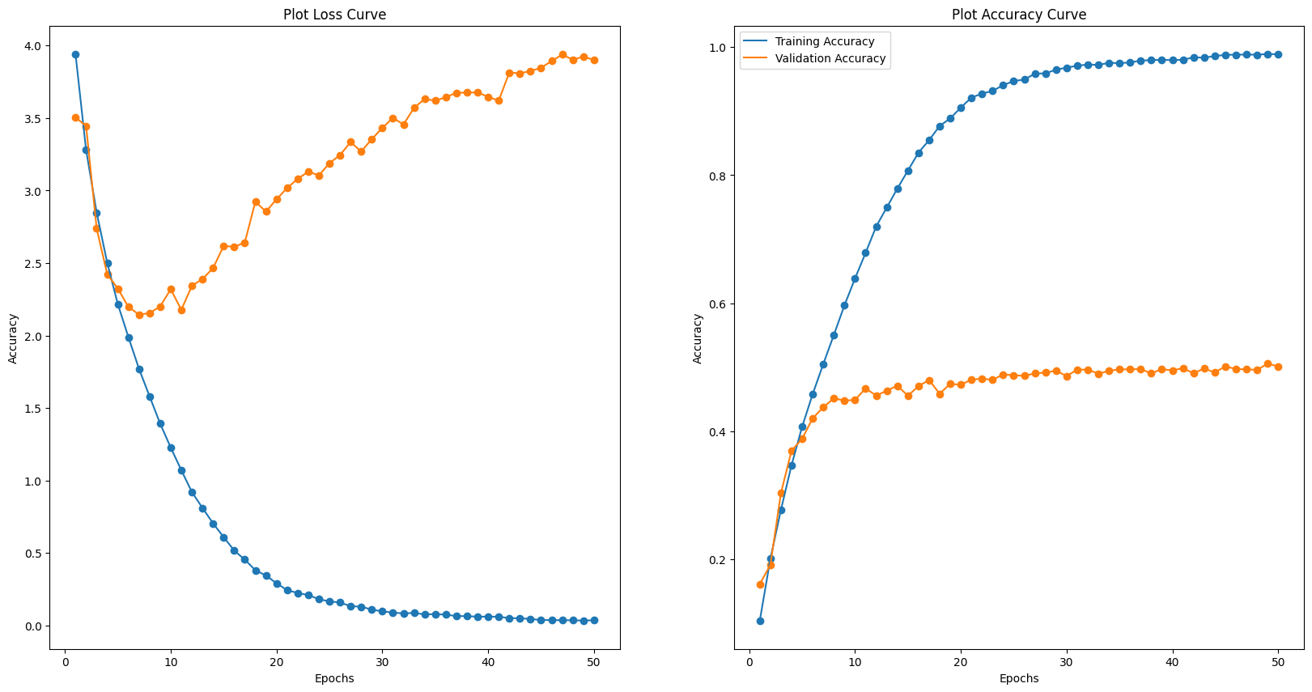
CustomVGG10 Model
Comparing our baseline model and customVGG model, we can see that the customVGG model is very overfitted as the validation loss is super high while training loss is super low. We need to do data augmentation etc to reduce overfitting.

Slide 18
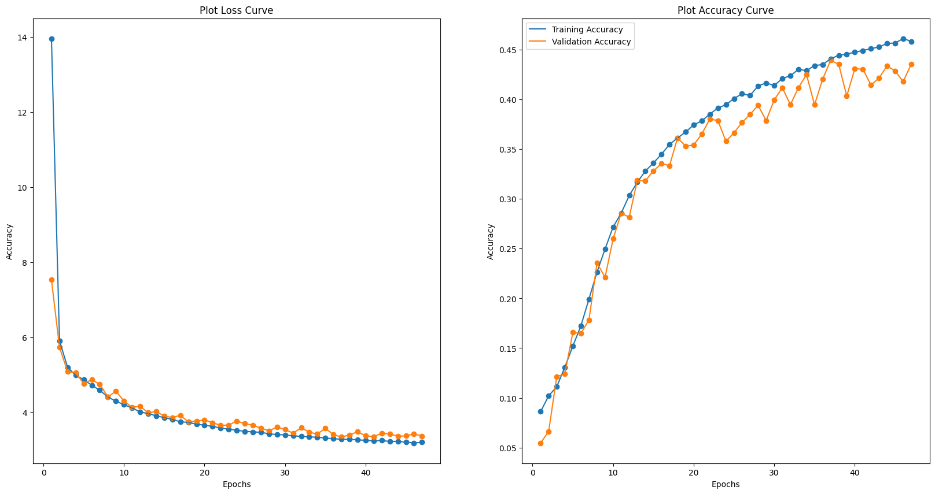
CustomVGG10 Model - L1
Even though by applying the L1 Lasso Regularisation, the model becomes generalise as both loss functions decreased. The decrease is consistent but the accuracy of both training and validation is slightly better than baseline and is worst that the normal conv2D model. This suggest the L1 Lasso Regularisation method is not very strong at improving the accuracy of the models.

Slide 19
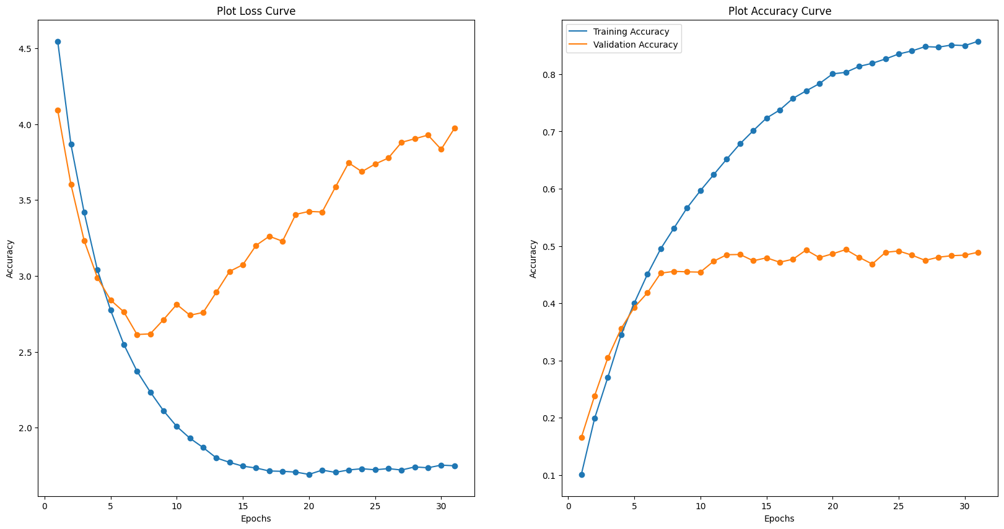
CustomVGG10 Model - L2
Comparing the CustomVGGL2 model and CustomVGG model, the accuracy of the validation data increased but there is an increase in training loss and validation loss. This suggest that the model has become less generalised even though a regularisation is suppose to help make the model more generalise and reduce overfitting.

Slide 20
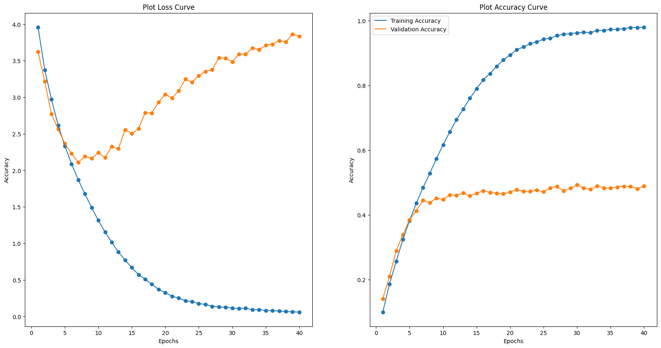
CustomVGG10 Model - Aug
Comparing customVGG model without Data Augmentation to the customVGG model with Data Augmentation, we can see that by applying augmentation, the train loss decreased and the train accuracy increase slightly.

Slide 21
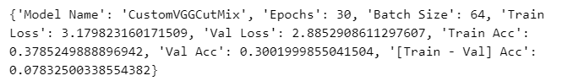
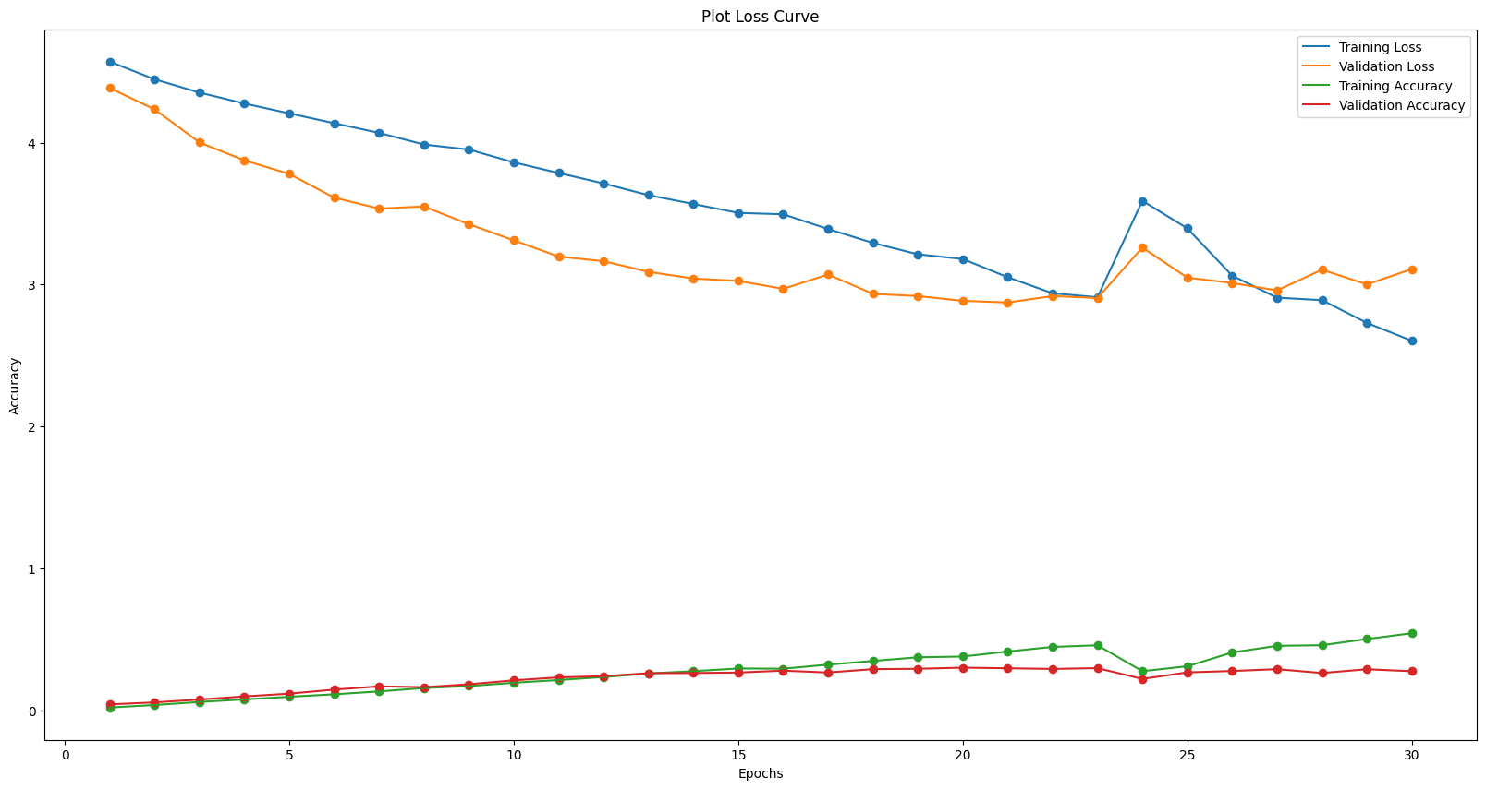
CustomVGG10 Model - CutMix
We can see that by applying cutmix, the training and validation accuracy decrease drastically. The decrease in the loss suggest that by applying the cutmix training set it makes the model more generalised to the validation set.

Slide 22
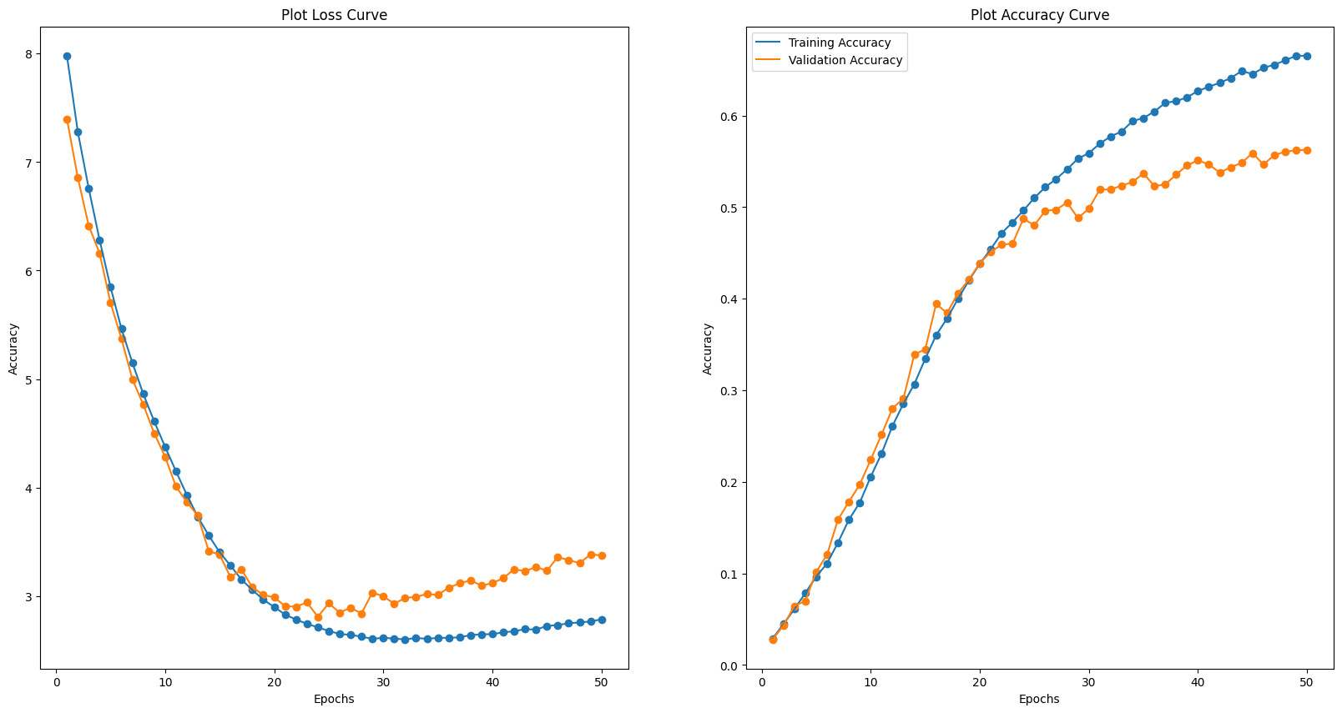
CustomVGG16 Model
We can see that after we have added more dropout layers, the model has become more generalised and that the both loss has been reduced significantly compared to the other models previously. This suggest that we should add more layers and increase the dropout to make model more generalise and prevent overfitting at the same time.

Slide 23
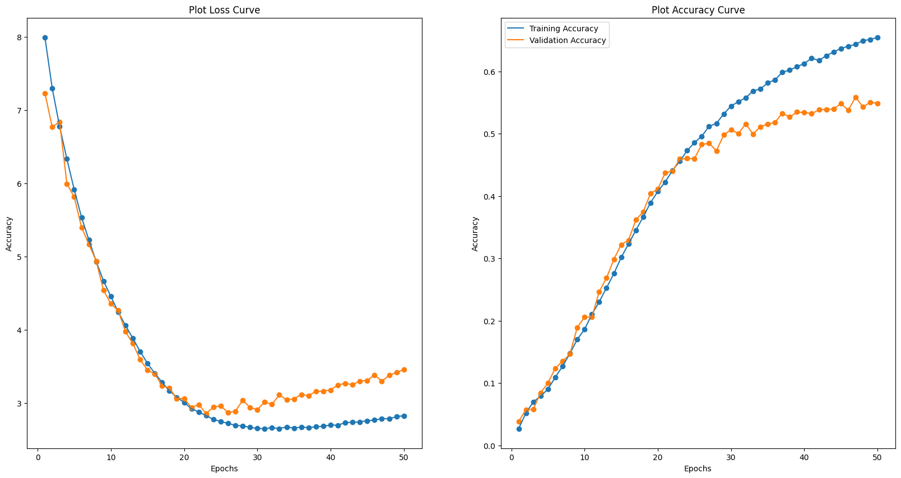
CustomVGG16 Model - Aug
We can see that the model has been very generalise and performance was better than the model that was not trained with the data augmentation. This means data augmentation for this model is very good.

Slide 24
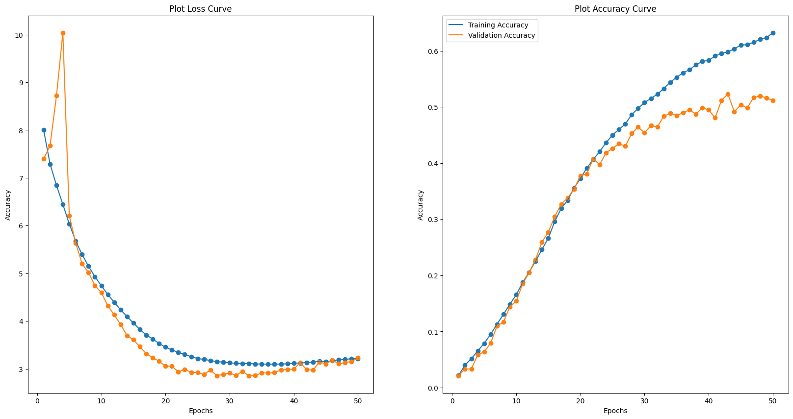
CustomVGG16 Model - CutMix
Comparing the customVGG-16 model that was not train with cutmix and was more generalised and the one trained on cutmix was more generalise to the validation set but has a lower accuracy. This suggest the model was slightly underfitted and this caused the accuracy to decrease.

Slide 25
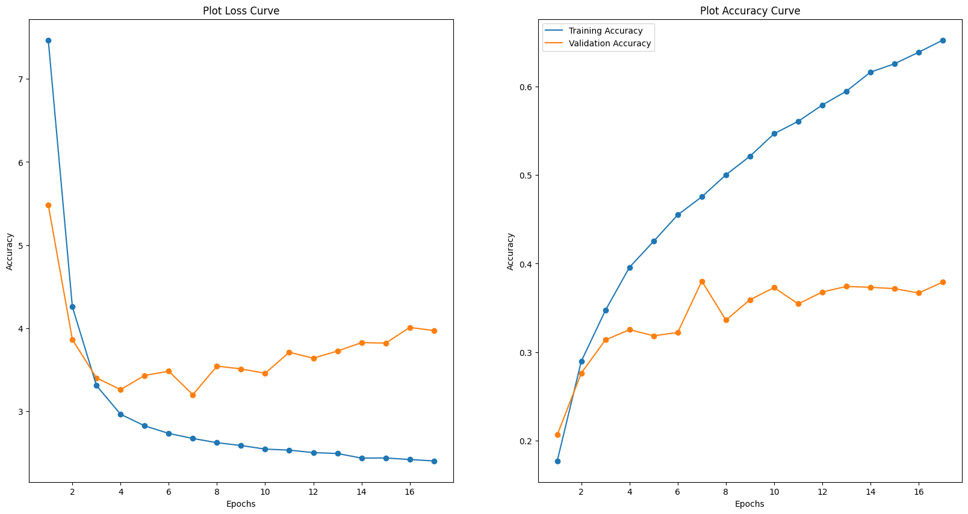
CustomResNet10 Model
Comparing the customResNet model to the baseline model, we can see that both train and validation accuracy increased. Train loss is decreased as well which means that the model is generalise to the training data. However, more tuning will be need to change and modify to reduce the loss.

Slide 26
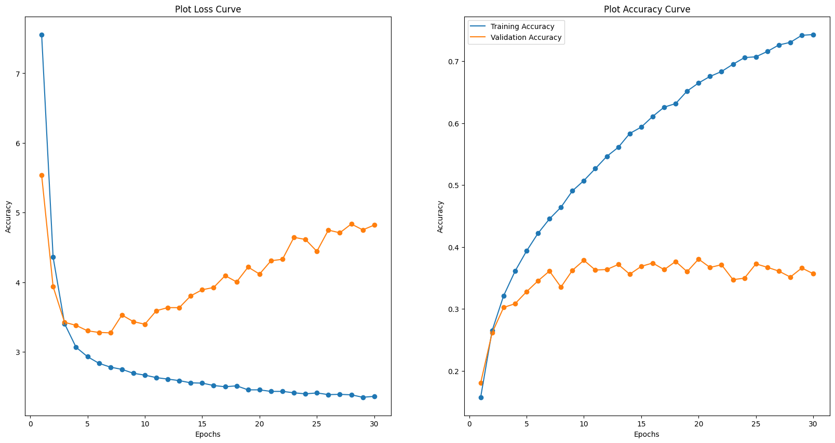
CustomResNet10 Model - Aug
By comparing the ResNet with Augmentation to ResNet without Augmentation, we can see that the validation accuracy plateau more and become more generalised. The validation accuracy and training accuracy also increase as well this suggest that augmentation improved the model.

Slide 27
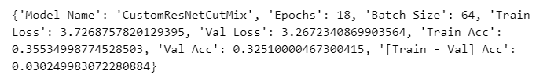
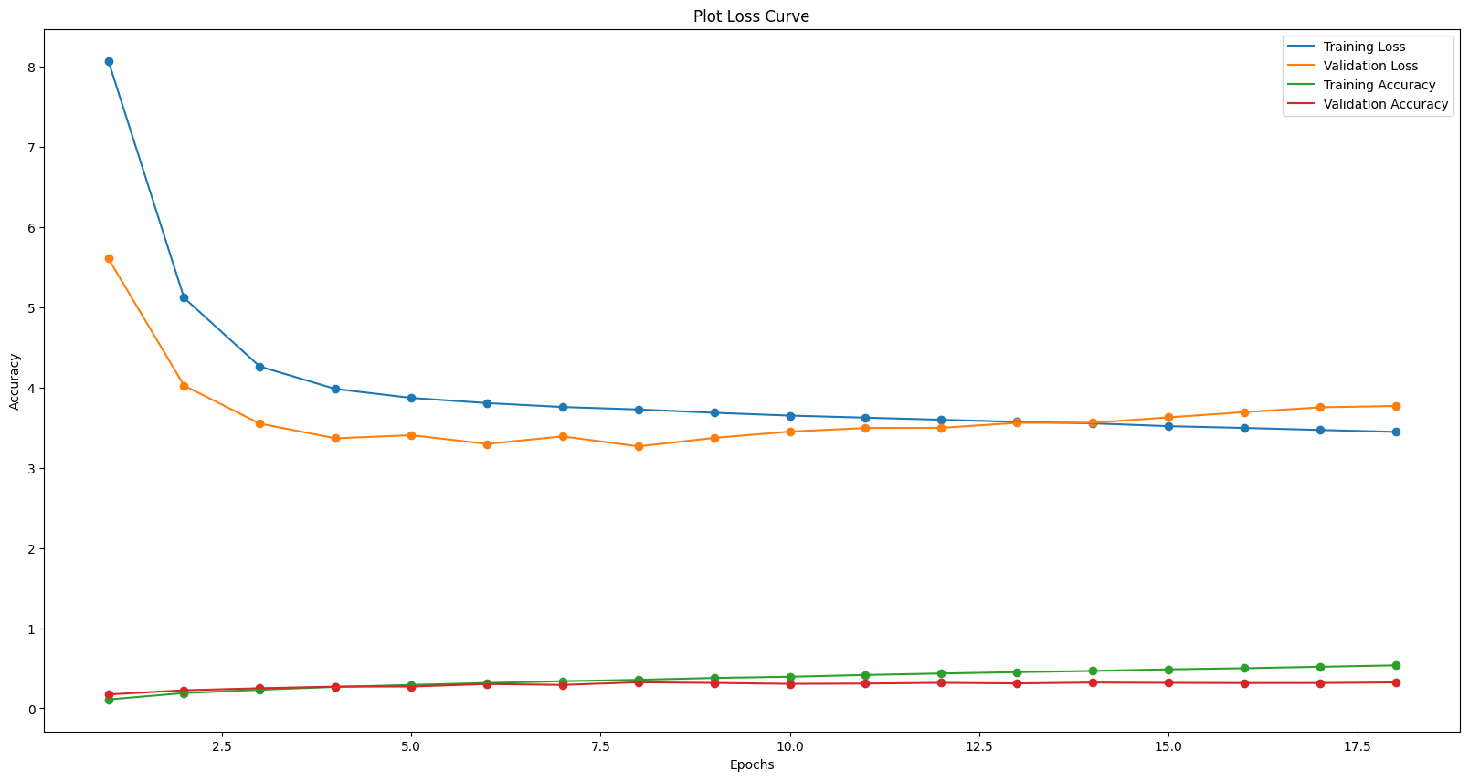
CustomResNet10 Model - CutMix
We can see that by applying the cutmix algorithm, the model becomes more generalise as the accuracy are very similar. However, although the model is generalise the accuracy is very low which means some changes needs to be done to make it better

Slide 28
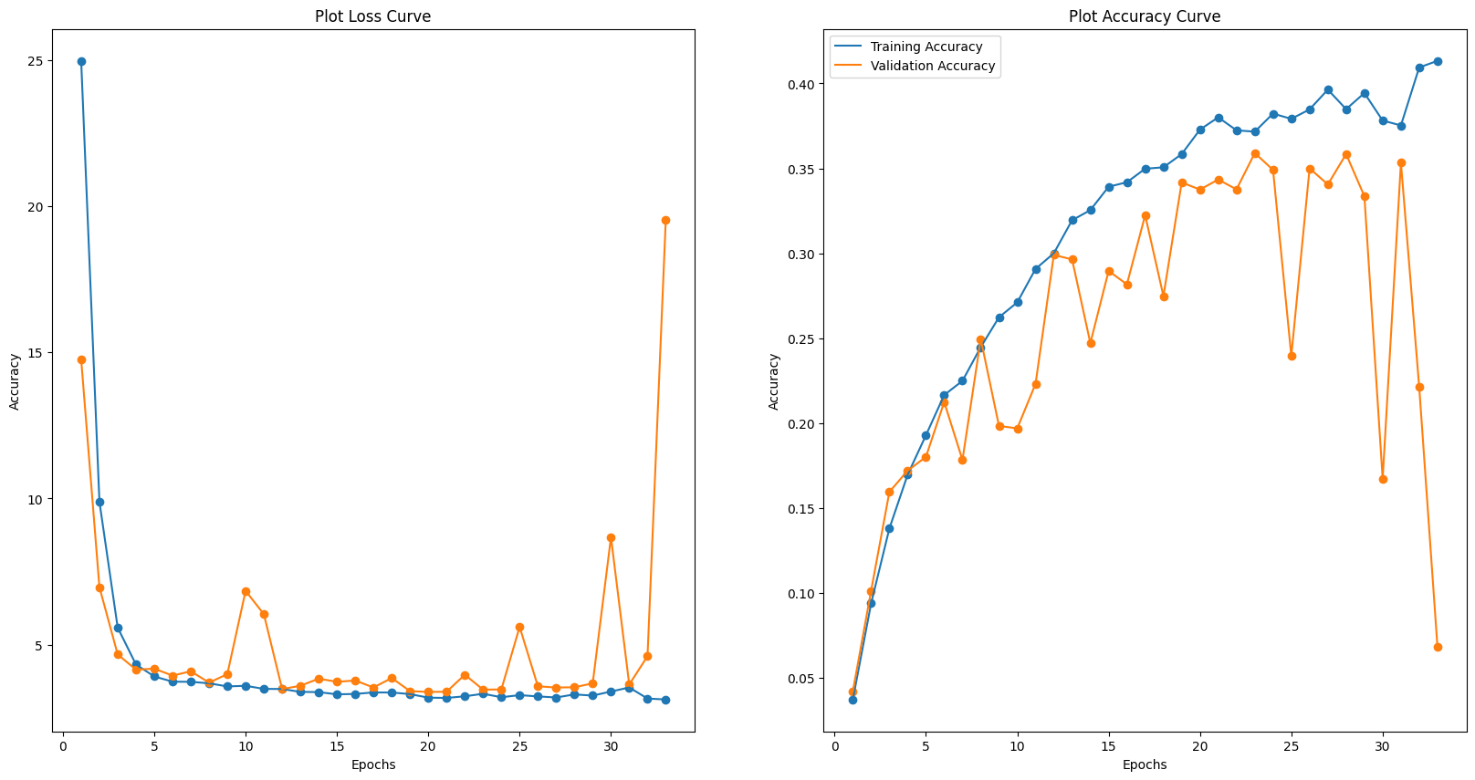
CustomResNet10 Model - Dropout
We can see that the model has a worst performance after applying dropout. This is likely because of the ResNet's batch normalization layers. When the two layers are put together, there will be a disharmony created. This is due too Batch Normalization layer having a normalization process which use the batch's mean and standard deviation. But the dropout layer will randomly drop the weights and bias in the network. This causes the model to lose the important weights [After the weights have been normalised] that is essential in the model's performance.

Slide 29
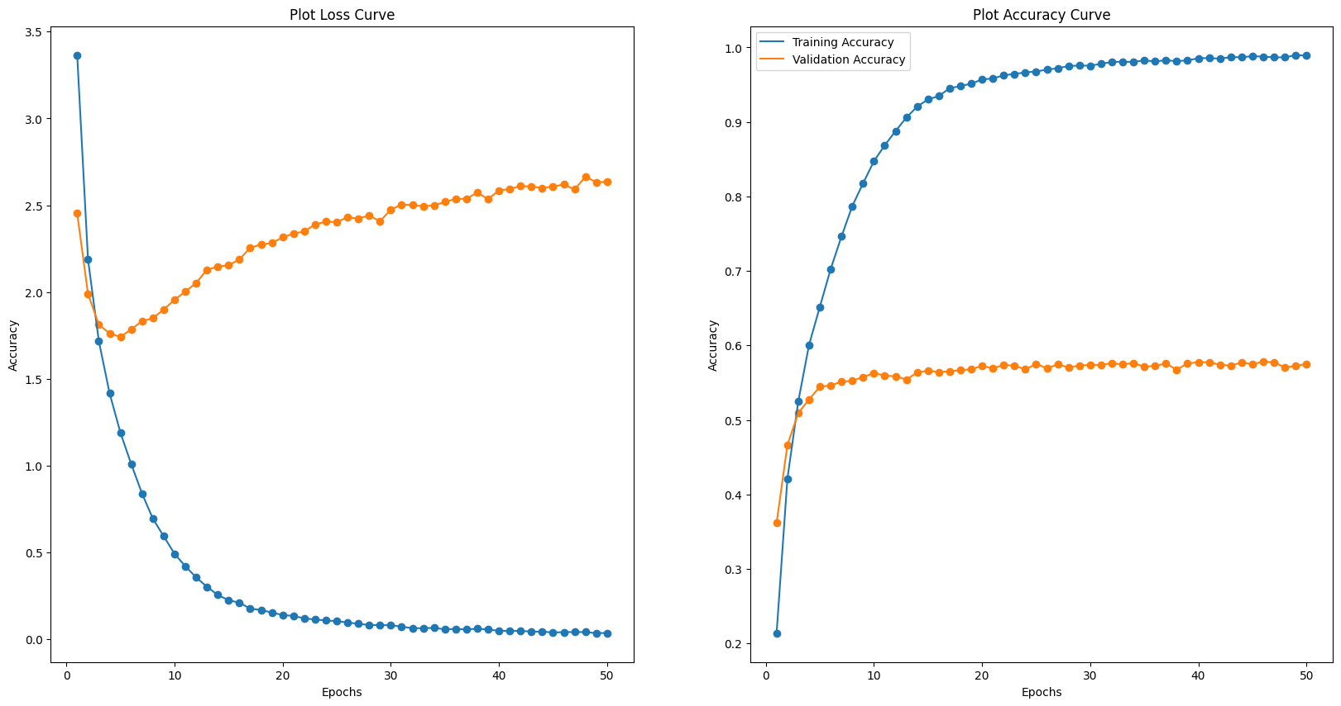
EfficientNetV2 Model
Comparing the EfficientNetV2 Model with the baseline model, we can see that the the model plateau and the model is able to generalise well. The accuracy of both training and validation improved which suggest that efficientNet is a good model.

Slide 30
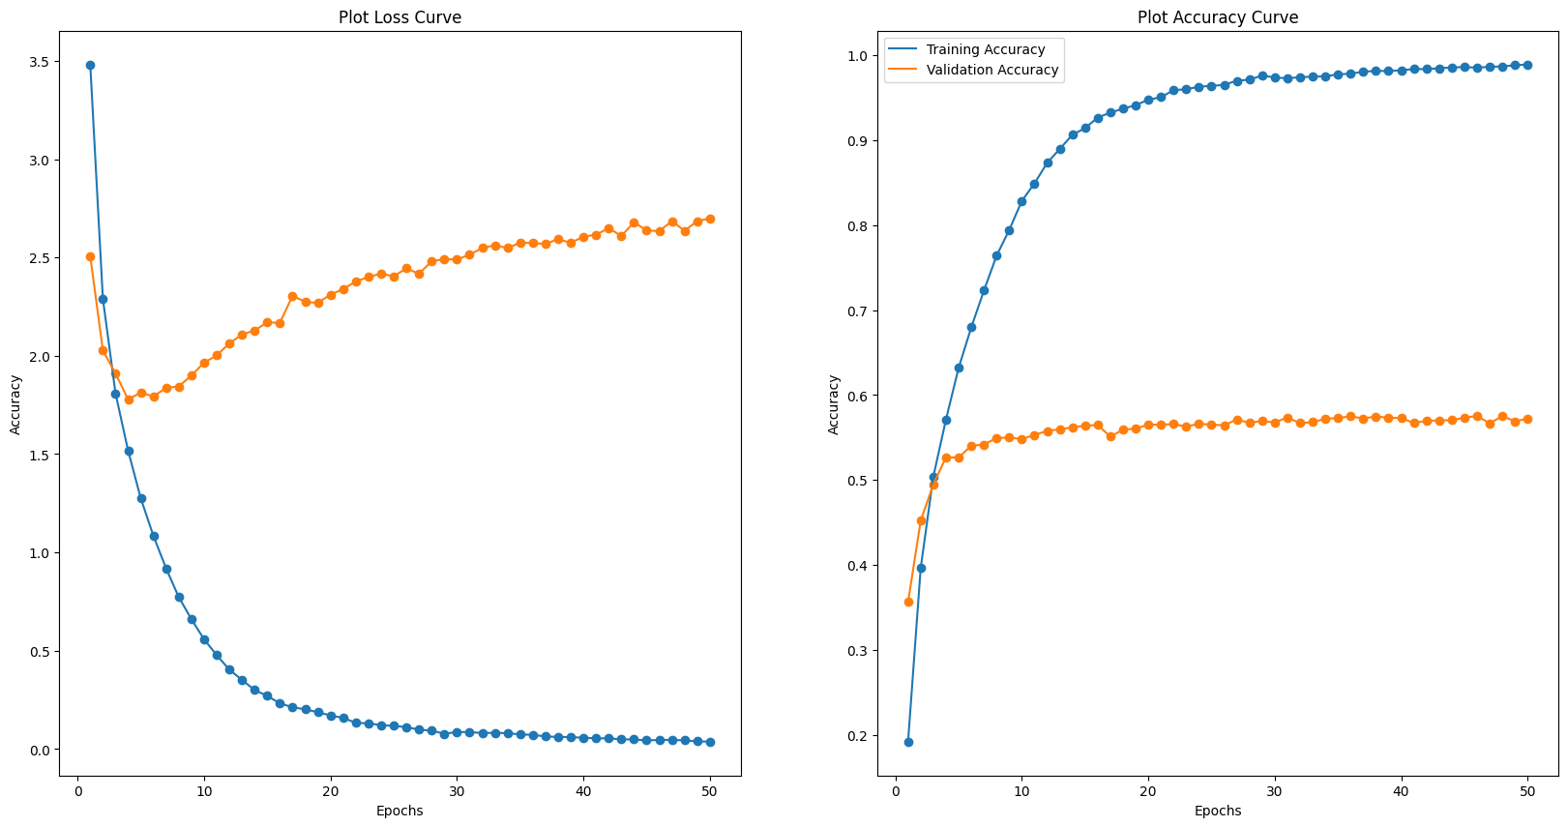
EfficientNetV2 Model - Aug
Comparing the EfficientNetV2 model with augmentation and model without augmentation, we can see that the model decreased slightly but the training and validation loss decreased which suggest the model fitting more generalise to the augmented data.

Slide 31
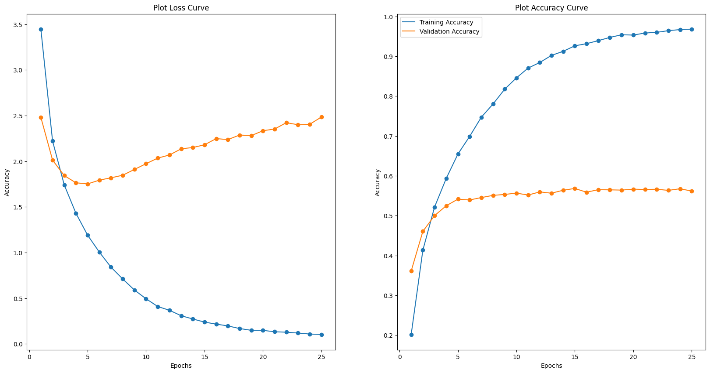
EfficientNetV2 Model - CutMix
We can see that the validation and training accuracy decrease slightly compared to the model that as train using the unaugmented dataset but the model trained with the cutmix model manage to be more generalise as the validation and training loss decreased

Slide 32
Coarse Dataset
- Cifar 100 -

Slide 33
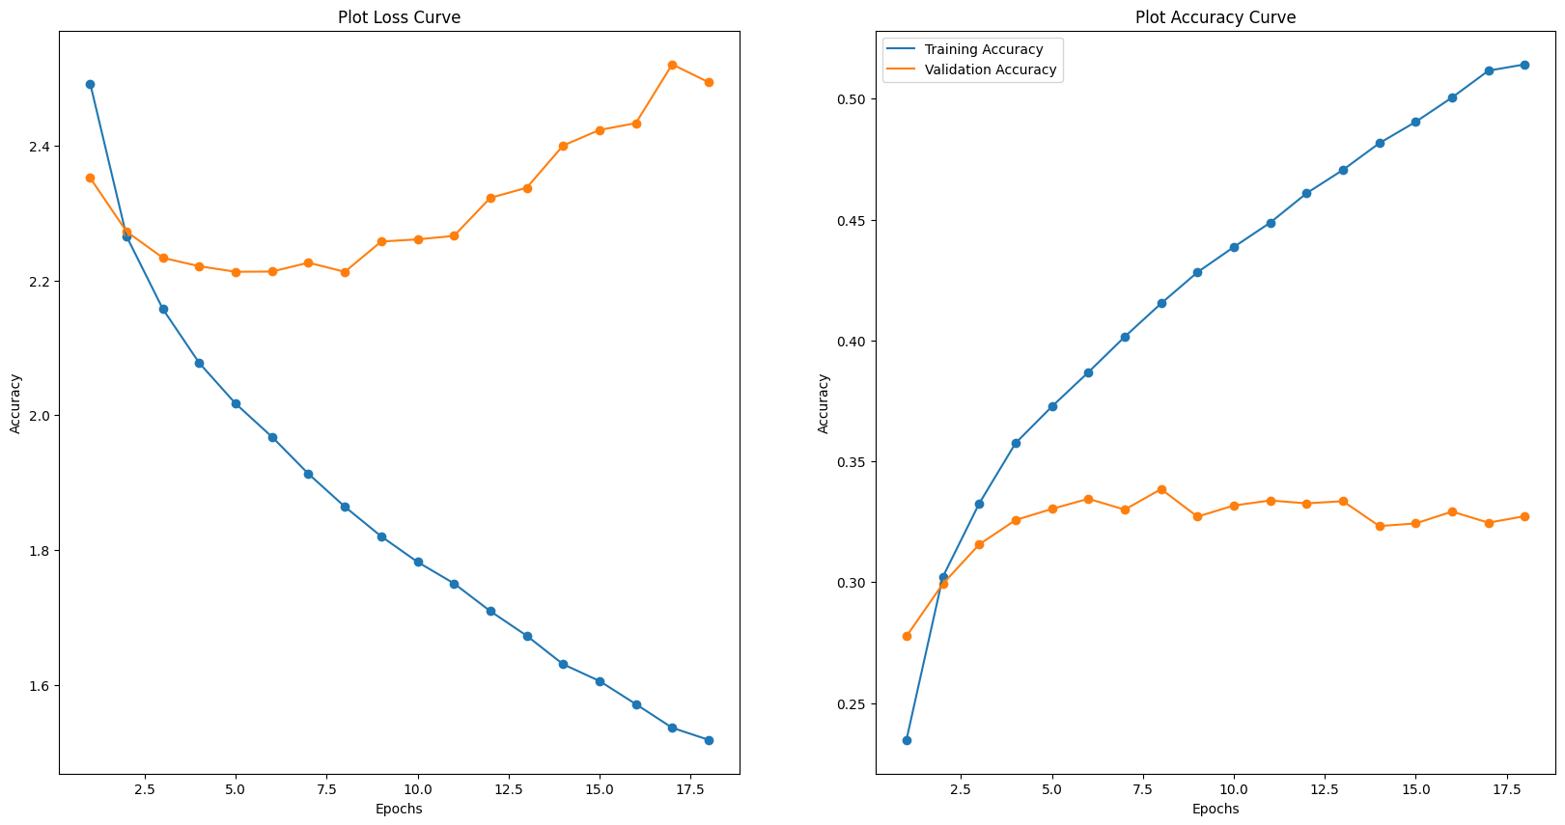
Baseline Model
We will build a baseline model with 3 hidden Dense layer.
From the loss curve, We can see that as the model increase in epochs, the model becomes more generalise and the loss functions starts decreasing too. However, the accuracy of both training and validation is very low at 41.5% and 33.8%. This means that the model is not very strong at predicting and it is similar to randomly choosing a label. Let's see if augmentations will improve the accuracy.

Slide 34
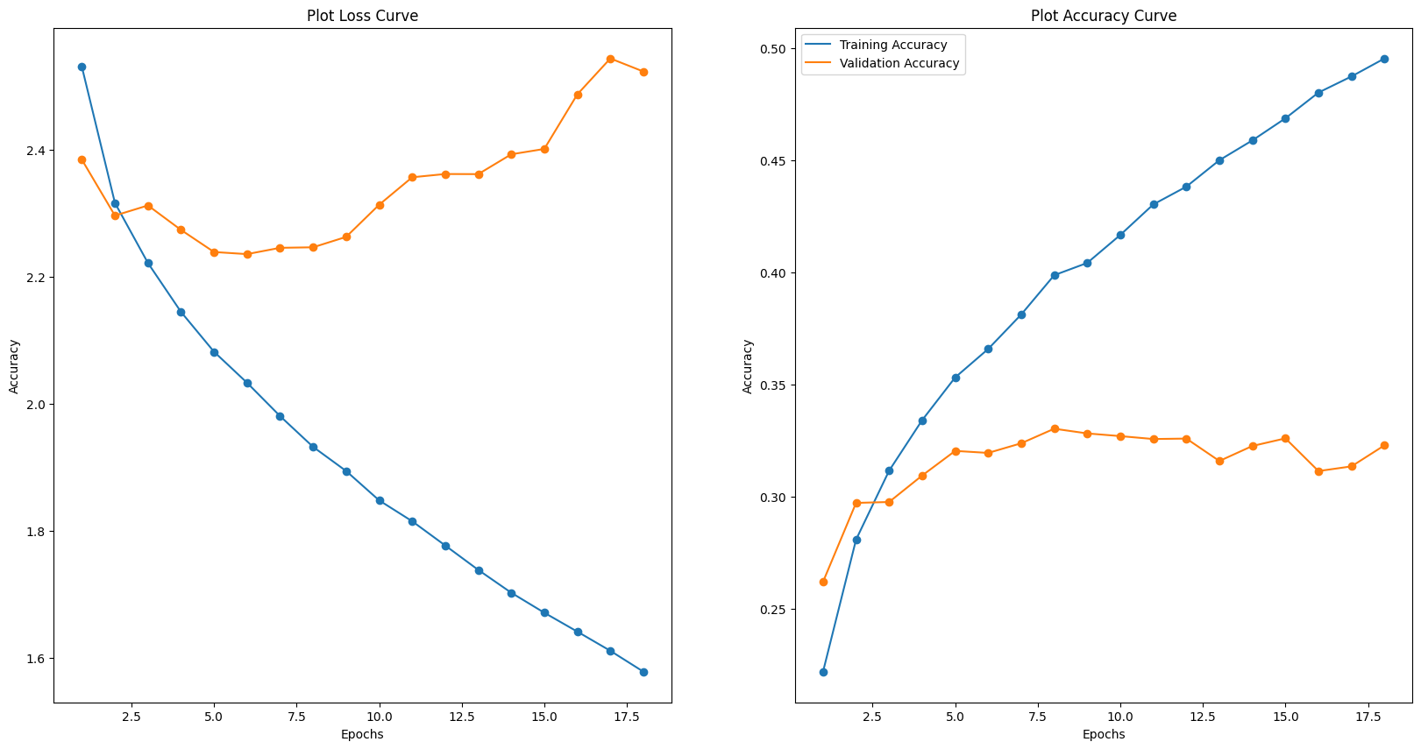
Baseline Model - Aug
We can also see that by augmenting the data, we see that even though the accuracy for both training and validation decreased, there is a slight increase in validation loss which means that the model is becoming less generalise to fit to the dataset. However, as the accuracy is still very low, more improvements need to be made to make the model better.

Slide 35
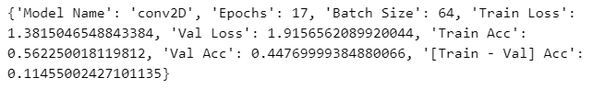
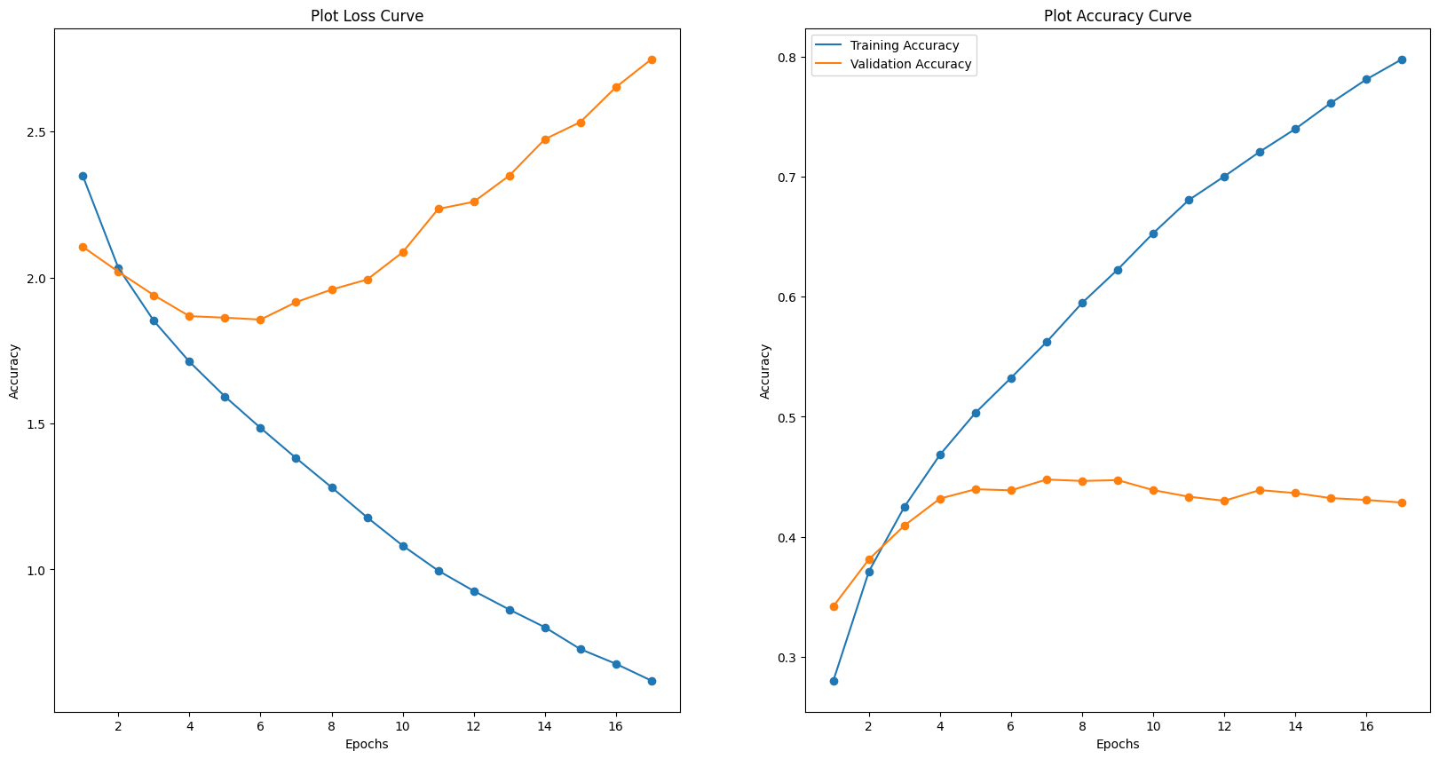
Conv2D Model
Comparing the Conv2D model with the baseline model, we can see that there is a significant difference in the training accuracy and validation accuracy. The loss functions decrease suggesting the model is performing better and generalising more

Slide 36
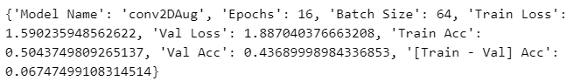
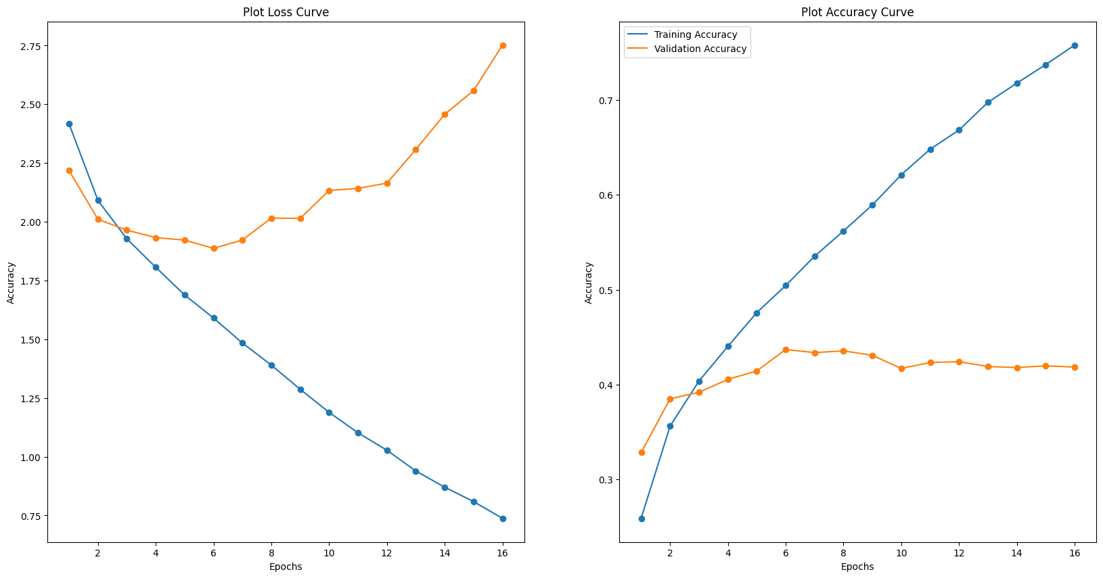
Conv2D Model - Aug
Comparing the augmented data trained under the conv2D model, we can see that although both training accuracy and validation accuracy decreased. But the model seem to be more generalise due to the loss functions decreasing. But more should be done.

Slide 37
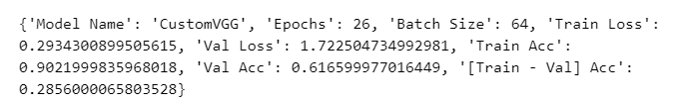
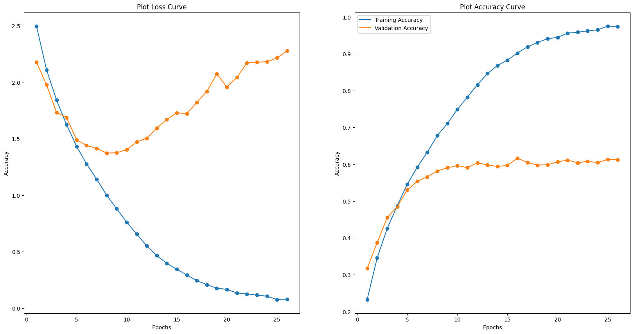
CustomVGG10 Model
Comparing our baseline model and customVGG model, we can see that the customVGG model is very overfitted as the validation loss is super high while training loss is super low. We need to do data augmentation etc to reduce overfitting.

Slide 38


CustomVGG10 Model - L1
Even though by applying the L1 Lasso Regularisation, the model becomes generalise as both loss functions decreased. The decrease is consistent but the accuracy of both training and validation is slightly better than baseline and is worst that the normal conv2D model. This suggest the L1 Lasso Regularisation method is not very strong at improving the accuracy of the models.

Slide 39


CustomVGG10 Model - L2
Comparing the CustomVGGL2 model and CustomVGG model, the accuracy of the validation data increased but there is an increase in training loss and validation loss. This suggest that the model has become less generalised even though a regularisation is suppose to help make the model more generalise and reduce overfitting.

Slide 40


CustomVGG10 Model - Aug
Comparing customVGG model without Data Augmentation to the customVGG model with Data Augmentation, we can see that by applying augmentation, the validation accuracy increase as well as the training accuracy almost being a 1. This suggest that augmentation is beneficial for a VGG model

Slide 41


CustomVGG16 Model
We can see that after we have added more dropout layers, the model has become more generalised and that the both loss has been reduced significantly compared to the other models previously. This suggest that we should add more layers and increase the dropout to make model more generalise and prevent overfitting at the same time.

Slide 42


CustomVGG16 Model - Aug
We note that the model reduced a lot of overfitting and become very generalise and performs better on the augmented dataset compared to the model that was trained without data augmentation. This means data augmentation for this model is very good.

Slide 43

CustomResNet10 Model
Comparing the customResNet model to the baseline model, we can see that both train and validation accuracy increased. Train loss is decreased as well which means that the model is generalise to the training data. However, more tuning will be need to change and modify to reduce the loss.

Slide 44

CustomResNet10 Model - Aug
By comparing the ResNet with Augmentation to ResNet without Augmentation, we can see that the validation accuracy plateau more and become more generalised. The validation accuracy and training accuracy also increase as well this suggest that augmentation improved the model.

Slide 45

CustomResNet10 Model - Dropout
We can see that the model has a worst performance after applying dropout. This is likely because of the ResNet's batch normalization layers. When the two layers are put together, there will be a disharmony created. This is due too Batch Normalization layer having a normalization process which use the batch's mean and standard deviation. But the dropout layer will randomly drop the weights and bias in the network. This causes the model to lose the important weights [After the weights have been normalised] that is essential in the model's performance.

Slide 46

EfficientNetV2 Model
Comparing the EfficientNetV2 Model with the baseline model, we can see that the the model plateau and the model is able to generalise well. The accuracy of both training and validation improved which suggest that efficientNet is a good model.

Slide 47

EfficientNetV2 Model - Aug
Comparing the EfficientNetV2 model with augmentation and model without augmentation, we can see that the model decreased slightly but the training and validation loss decreased which suggest the model fitting more generalise to the augmented data.

Slide 48

Model Selection - Fine
It seems like the efficientNetV2 model [pre-trained] performed the best. However, out of all the custom models, the VGG16 and VGG10 model performed the best. Therefore we will be making model improvements to the customVGG16 model and comparing the results to see if it is better than the efficientNetV2 Model.

Slide 49

Model Selection - Coarse
It seems like the CustomVGG16 Augmented model performed the best followed by the pretrained efficientNetV2 model. Therefore we will be making model improvements to the customVGG16Aug model.

Slide 50

Fine Model Improvement - CustomVGG16
For the CustomVGG16 model, we will be trying a few things.
Using a learning rate scheduler [Cosine Annealing]
Using keras tuner to RandomSearch to find the best parameters
For tuning, we will be using Keras Tuner - RandomSearch
Weight Decay = 0.0003 - 0.01
Learning Rate = 0.001 - 0.1

Slide 51

Coarse Model Improvement - CustomVGG16
For the CustomVGG16 model, we will be trying a few things.
Using a learning rate scheduler [Cosine Annealing]
Using keras tuner to RandomSearch to find the best parameters
For tuning, we will be using Keras Tuner - RandomSearch
Weight Decay = 0.0003 - 0.01
Learning Rate = 0.001 - 0.1

Slide 52
Tuned Model Selection
FINE
After tuning the model, we will compare both models in terms of validation accuracy. We can see that customVGG16 is better than efficientNetV2B0 model as the validation accuracy is 0.6098999977111816 while the efficientNetV2B0 model has a validation accuracy of 0.578200.
Therefore after careful selection consideration, we will be using the customVGG16 model instead of the efficientNetV2B0 model
COARSE
After tuning the model, we will compare both models in terms of validation accuracy. We can see that customVGG16 is better than efficientNetV2B0 model as the validation accuracy is 0.7368000149726868 while the efficientNetV2B0 model has a validation accuracy of 0.691000.
Therefore after careful selection consideration, we will be using the customVGG16 model instead of the efficientNetV2B0 model

Slide 53


Model Evaluation
FINE
We can see from the classification report that the model is very good at identifying and differentiating lawn_mower, sunflower, palm_tree and pickup_truck but not as good as predicting lizard, otter, rabbit and seal. Let's do a mini error analysis and find out why.

Slide 54


Model Evaluation
COARSE
We can see from the classification report that the model is very good at identifying and differentiating trees, flowers and people but not as good as predicting aquatic mammals, reptiles, small mammals and non-insect invertebrates. Let's do a mini error analysis and find out why.

Slide 55

Error Analysis - Fine
When we look at the examples that the model made a wrong prediction, we can identify some reasons why it is the case.
Low pixel resolutions makes images hard to be distinguished.
Example: Row 2 Column 4
That images looks a bunch of pixels [Due to low resolutions] and it is hard to distinguish the features.
Similar features
Example: Row 4 Column 4
The model predicted the values of a mouse and shrew wrongly. This is likely due to both mouse and shrew being mammals and having similar features like having a tail and big ears.
Color similarity
Example: Row 4 Column 5
Both roses and tulips come in many different colors. The model is likely confused by the color and therefore mixed up the prediction
Background noise
Example: Row 6 Column 5
Even though the label is butterfly, almost half the image is a flower. This might have caused the model to predict the flower instead of the butterfly.
Therefore, it appears that the model's mistakes are reasonable.

Slide 56

Error Analysis - Coarse
When we look at the examples that the model made a wrong prediction, we can identify some reasons why it is the case.
Low pixel resolutions makes images hard to be distinguished.
Example: Row 2 Column 2
That images looks a bunch of pixels [Due to low resolutions] and it is hard to distinguish the features.
Close Up
Example: Row 3 Column 4
The model predicted the values of a medium sized mammals and large carnivores wrongly. This is likely due to image very close and making it seem like the animal is a carnivores based on the teeth in the image.
Therefore, it appears that the model's mistakes are reasonable.

Slide 57

Summary
Based on PapersWithCode.com, our final model is ranked 165th out of the 183 models [Not inclusive of ours].
In summary, I experimented with various models using transfer learning and tried different image augmentation approach. More room for improvement can be made like tuning the efficientNetModel and using techniques like ensemble as well as using other callbacks like ReduceLROnPlateau to make training faster and improve accuracy.

